Slide 1

Canadian perspective
The HOME Society
Developing Relationships
Unconditional love is the central care giving and cultural phenomenon required in care giving: Each person’s circle of caring, program, or supportive intervention should be measured against the standard for the on-going expression of unconditional love. Love is defined as acceptance of the person, respect for him/her, the desire to nurture and the act of nurturing when troubled, the on-going expression of love, honor, and respect through all care giving presence, words, and deeds. Love given unconditionally is its expression during good moments and difficult ones. However, if it is not given during good moments, it will have no meaning during hard ones.

Slide 2
Developing Relationships
Movement away from individualism and toward companionship and community: Each person’s community of caring needs to assure that companionship and community-making are the main focus of any and all interventions, programs, and supports. The community needs to understand that an individual’s growth and development is directly related to his/her connectedness with others. A sense of companionship relates to the evolving and intentional depth and breadth of the person’s connectedness with his/her caregivers and circle of friends. Movement away from feelings of solitude and apartness and toward companionship and community result in healing and well­being. Companionship arises from a series of face-to-face relationships that, when put together, form community.
.

Slide 3
Developing Relationships
. Movement away from independence and toward interdependence: Most modern supportive systems have been founded in the call for individualism—a sense that each must stand on his/her own and the peak of human development is independence. While independence is seen as a moral good, it does not have primary value. Without denigrating its secondary role in human development, independence must be seen as emerging out of human interdependence. There can be no real or meaningful independence without being strongly connected to others. It is in each person’s circle of friends, that interdependence is created and from this human independence. These personal face-to-face relationships, when looked at from the collective group’s perspective and modes of interacting, form community. John McGee A Culture of Life

Slide 4
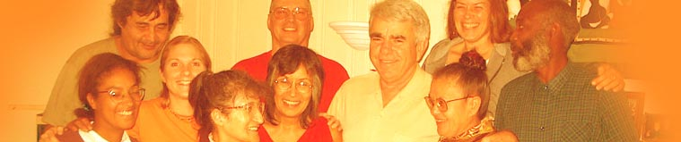
A call to Change
Gentle Teaching is many things. Gentleness toward others, in spite of what anyone does or does not do, is the critical factor.
It is a paradox. Fists are met with hugs. Cursing is met with words of affection and nurturing. Spiteful eyes are met with warmth.
Gentleness recognizes that all change is mutual and interwoven. It starts with caregivers and, hopefully, touches those who are most marginalized.
Its central focus is to express unconditional love. It is the framework around a psychology of human interdependence.
The main idea of gentleness is not to get rid of someone else’s behaviors, but to deepen our own inner feelings of gentleness in the face of violence or disregard.

Slide 5
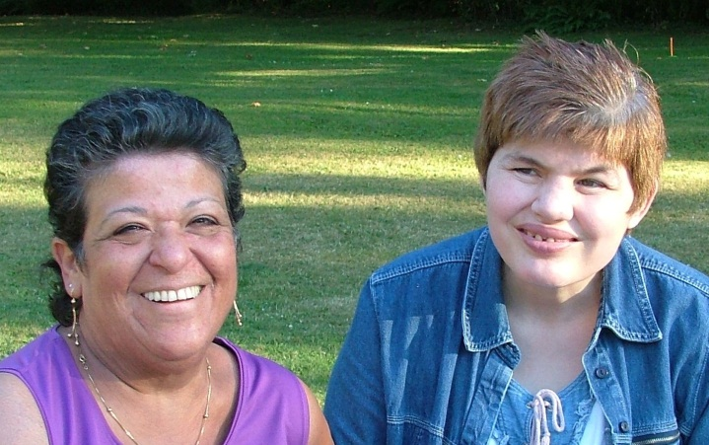
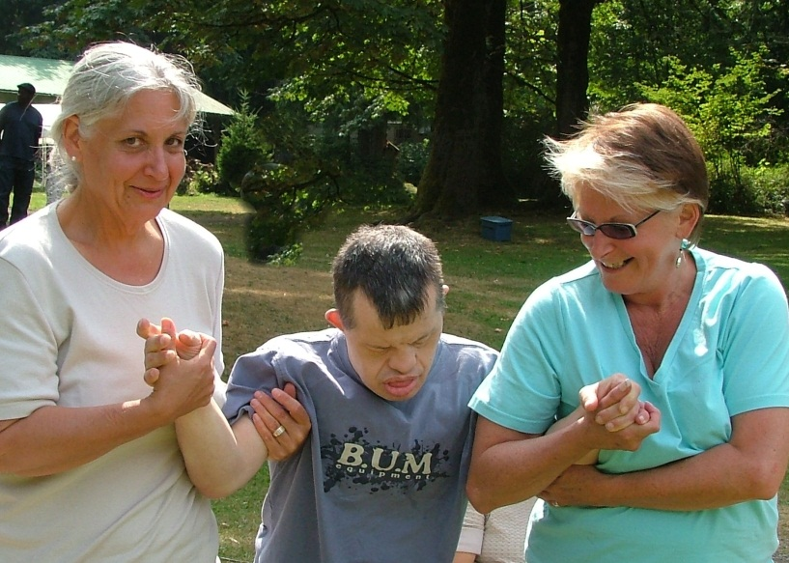
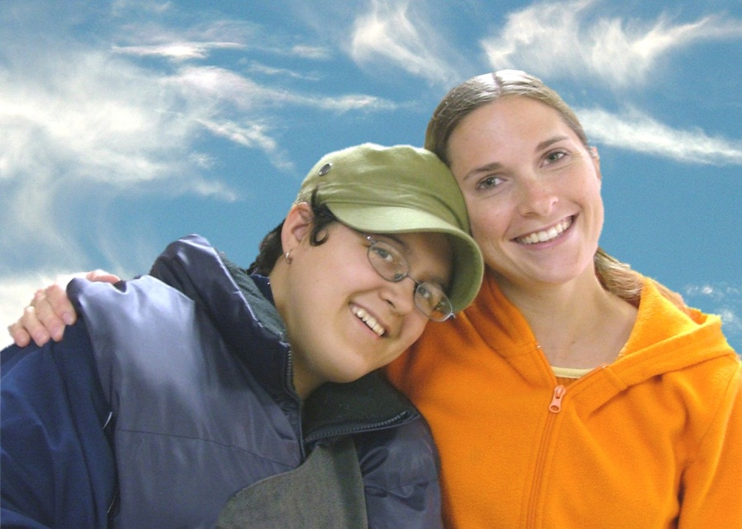
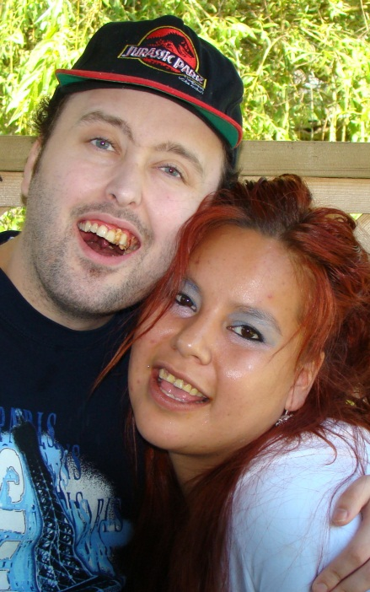
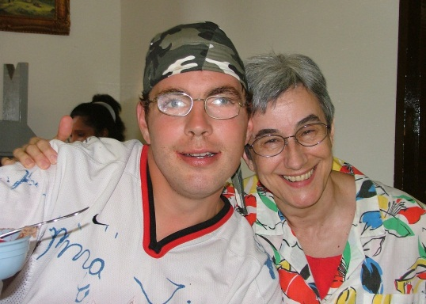
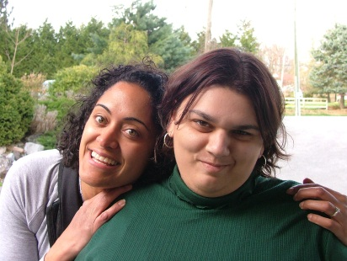
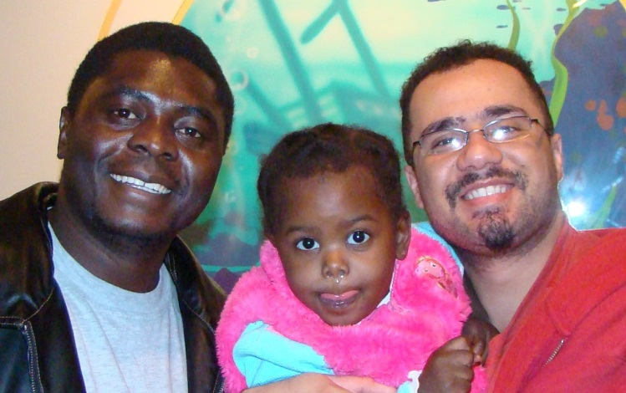
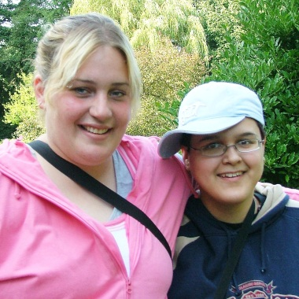
The H.O.M.E. Society
Healthy Opportunities for Meaningful Experience Society
Based in Abbotsford BC
Established 1994

Slide 6
Our Beginning
The H.O.M.E. Society was formed to respond to the needs of 16 individuals who had not succeeded in previous attempts to leave institutional life and return to the community
The society grew out of a coalition of managers from 5 existing societies, family members and staff from the former institution. There was also a commitment on the part of the funders (The Ministry of Children and Families) to work closely with HOMES in developmental stages. Many of the support services were consolidated within the agency for quick response.
Finally there was a major focus on the environment and neighborhood. Homes were designed to allow the men and women we serve to succeed despite challenging behaviours. Working closely with BC Housing and the architects enabled us to find rural sites, which allowed distance from neighbours and enough space and options to allow energetic and productive living in a community setting.
  “When we are no longer able to change a situation, we are challenged to change ourselves.” ~Victor Frankl

Slide 7
Our Focus
Individuals who have not had a chance to live in a community home.
Rural settings with a focus on building and contributing to local Community.
Training and Education
Celebrating and sharing the skills and gifts of caregivers and those men and women we serve.
We are a Society mentored by John McGee and dedicated to a philosophy of Gentle Teaching. Our success in building a community of support for individuals previously labeled as very challenging and unable to live in the community, is based on adopting a philosophy of Gentleness.
We also share with Jack Pearpoint & the late Marsha Forest (Inclusion Press) the strong belief of commmunity living for all.
The work of Norman Kunc and Emma Van der Clift (Credo of Support) has helped us recognize that the days of modifying persons labeled disabled are over.
God grant me the serenity to accept the people I cannot change, the courage to change the one I can, and the wisdom to know it's me. ~Author Unknown

Slide 8
Our Mission
To welcome men and women returning from Institutions to a home in the Community.
To link with rural neighbours, friends and relatives to provide a circle of support in the lives of those we serve.
To support the community we live and work in by sharing the gifts and skills of the individuals within the H.O.M.E. Society: by contributing to the local economy and by supporting community agencies and events.
“Everyone thinks of changing the world, but no one thinks of changing himself.”
- Leo Tolstoy

Slide 9
Hire Neighbours…
We work hard to hire immediate neighbours
Our office as an example has had 5 immediate neighbours working for us who all started as young teens.
We buy locally and try to develop local talent and entrepreneurs
“The most powerful agent of growth and transformation is something much more basic than any technique: a change of heart.” - John Welwood

Slide 10
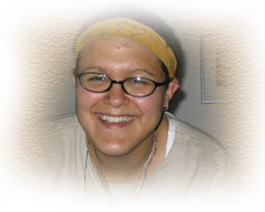
First Nations…
We have had First Nations Elders and Sun Dancers working with HOMES Caregivers and the people we serve.
We have a dozen First Nations women and men giving care and support.
We have been blessed with Traditional Ceremonies that include the Pipe, Sweats, Drumming and Healing Circles.
“The journey from the head to the heart takes time, effort and, loving support” Elder Bette

Slide 11
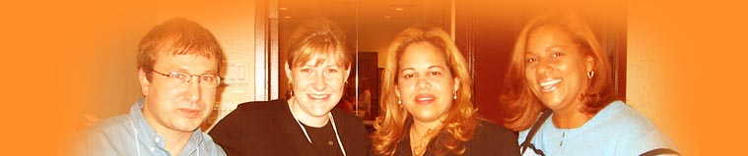
Gentle Teaching International
We are the home of GTI - Gentle Teaching International
We have visitors from throughout the world looking at our homes and sharing our learning
We are mentored by John McGee
The goal of Gentle Teaching is companionship

Slide 12
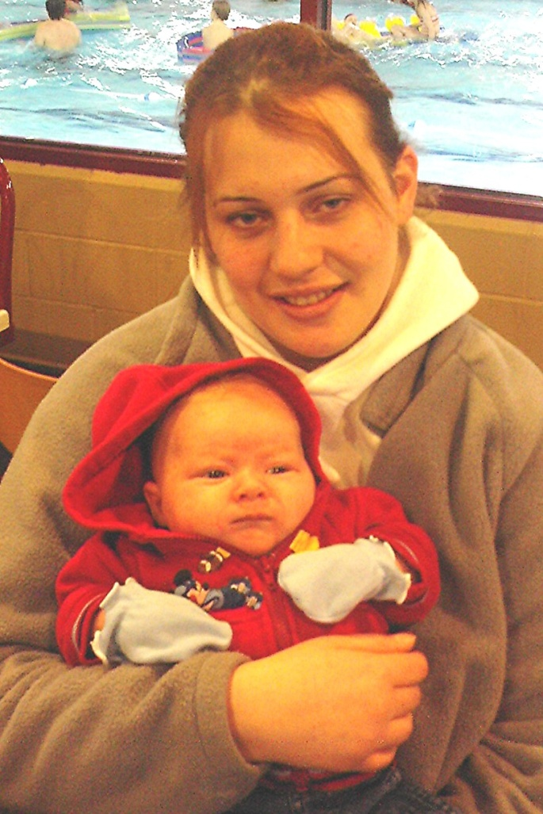
Psychiatric support
Most of the men and women we support have a dual diagnosis
We contract for both psychiatric and psychology support. Both are in house.
We have good individualized protocols with both Abbotsford and Langley Hospitals/Psychiatric Police and Forensic units

Slide 13

Quick Response Teams
We surround those individuals who will need quick response with a team of care givers prepared to act quickly. This team includes care givers, supervisors, co-coordinators and managers.
This team may relieve each other numerous times in a day.
The team members act as companions even in the middle of a crisis.
All of our Coordinators and the E.D. have emergency respite options in their homes.

Slide 14
Reasons for Referrals
Closing Institution - Last 16 @Woodlands
Repeated failed placements
Emergency placements
Too violent for Willow
Willow and Forensic Services referrals
Rotating homes (3-5 year)
Family initiated
First Nations - Culture

Slide 15
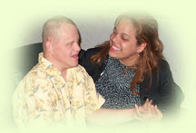
HOMES Family
Circle of support for HOMES
  Mentored agencies
  Gentle Teaching International
Flow
  One or two person home
  Four or five person home or
  Supported Family Care
Tied together by activities, celebrations and a Welcoming Office where everyone gets a round hugs.

Slide 16
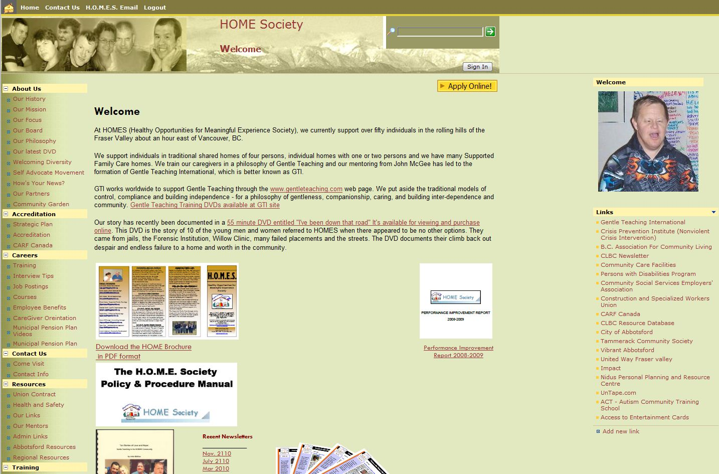

Slide 17
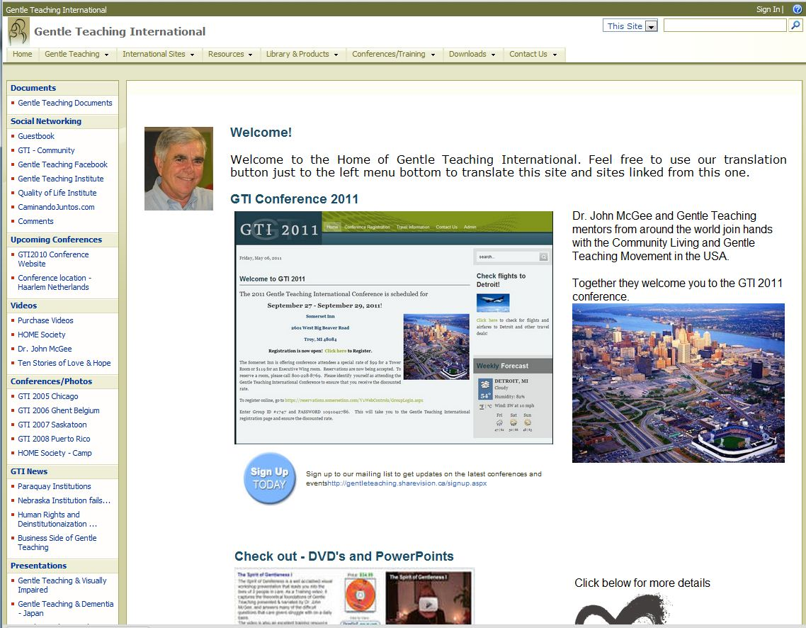

Slide 18
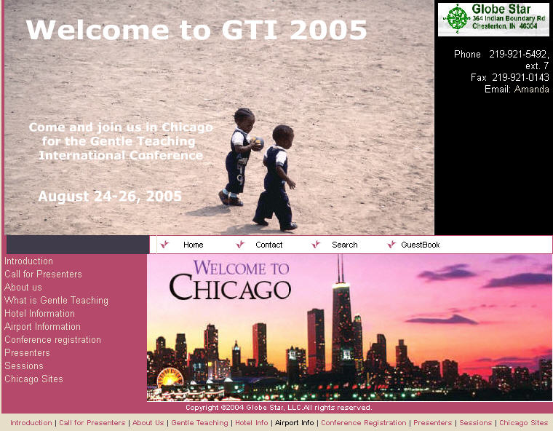
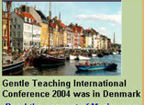
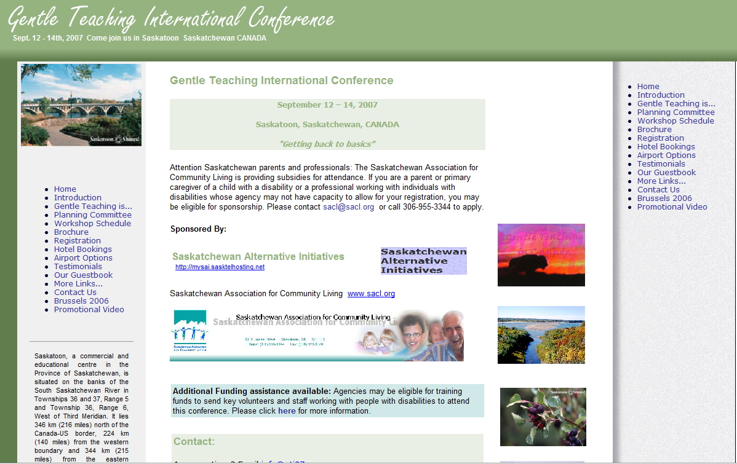
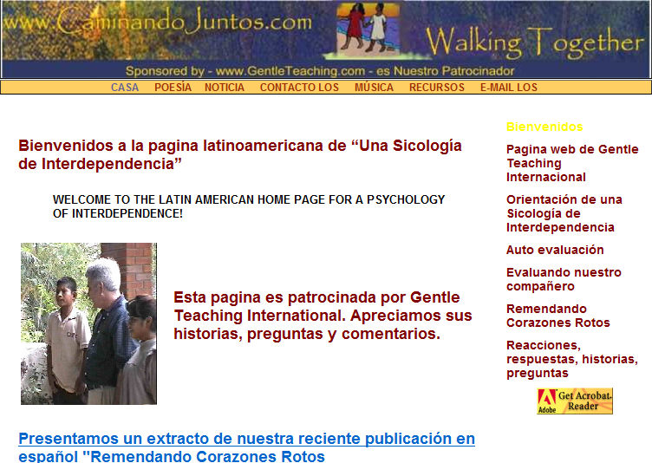

Slide 19
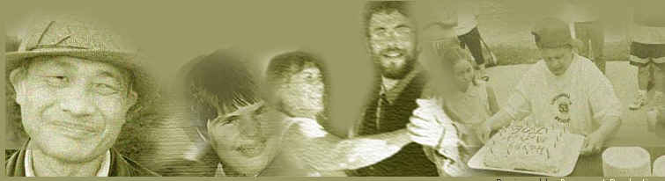
A Focus on Change
We were committed to changing
  Our Agency
  Our Processes and
  Our Selves

Slide 20
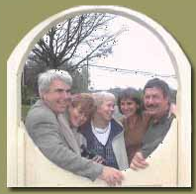
Agency Change
Need to provide 24/7 response by Coordinators and Ex. Dir.
Fluid response and transitions – no failures, no more revolving doors, use of in home emergency respite
Commitment to work closely with external agencies; Police, 911, Emergency Services, Mental Health, Forensics, and Courts

Slide 21
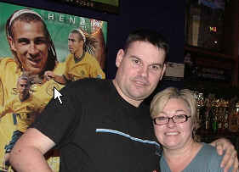
Change our Approach
Gentle Teaching Philosophy
Warmth – 1,000 hugs a day
Support Families - No more blame
Change language- Companions, care givers, those we support, the person you hangout with.
Use of Mentors
Welcoming Neighbours
Constant Evolution of HOMES
The HOMES family – Life time commitment

Slide 22

Change our own lives
Keep each other safe and valued
Open our homes to those were support
Involve our families – GT is a Way of Life
24/7 response from managers
Reach out to families and neighbours
Mentor and honour our care givers
1,000 hugs a day for our own families and those we support.

Slide 23
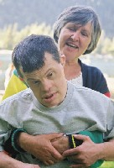
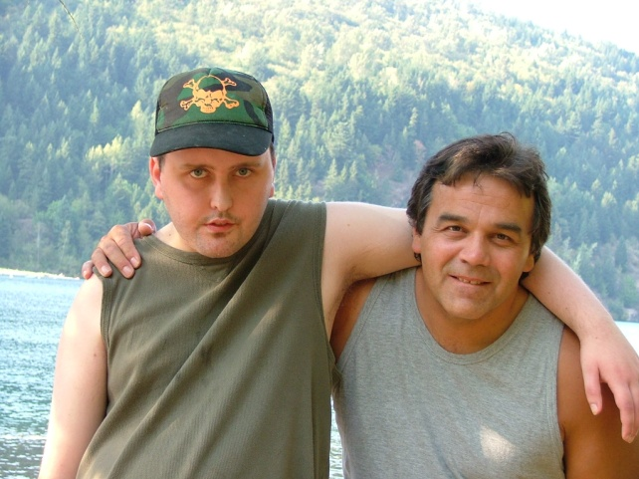
Our dual Focus
Those individuals coming from years of institutionalization
Young folks who repeatedly failed to live in the Community. Often FAS, may live with Personality Disorders, Dual Diagnosis, often known to the Legal System

Slide 24

Those individuals coming from years of
Institutionalization
www.WeSurvived.net
Gentle Teaching is many things. Gentleness toward others, in spite of what anyone does or does not do, is the critical factor. It is a paradox.
Fists are met with hugs. Cursing is met with words of affection and nurturing. Spiteful eyes are met with warmth.
Gentleness recognizes that all change is mutual and interwoven. It starts with caregivers and, hopefully, touches those who are most marginalized. Its central focus is to express unconditional love.
The main idea of gentleness is not to get rid of someone else’s behaviors, but to deepen our own inner feelings of gentleness in the face of violence or disregard.

Slide 25
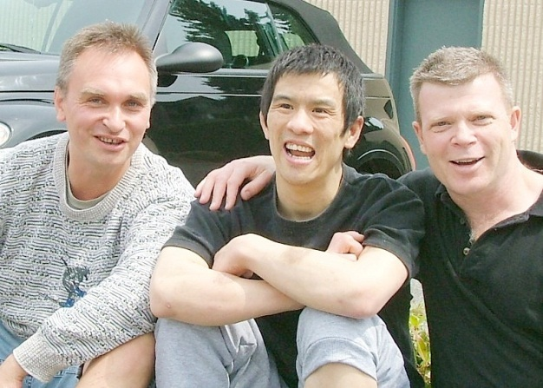
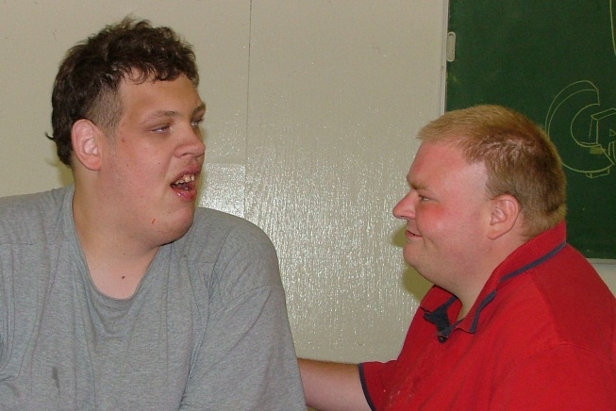
Transition from Institution
Visits to Institution
  Reports tell the worst
  Use an informal friendly approach
  Which care givers are the favourites?
  What’s the off the record description?
New home preparation
  Martha Stewart approach- colours, texture, smells, sounds, lighting, and furniture
  Food- snacks, drinks, treats, varied locations
  Use food to explore home and surroundings
  Food becomes a way of connecting
Welcome Ceremony
Group gathers to honour and Welcome new arrivals. May include drumming and smudging ceremony.

Slide 26
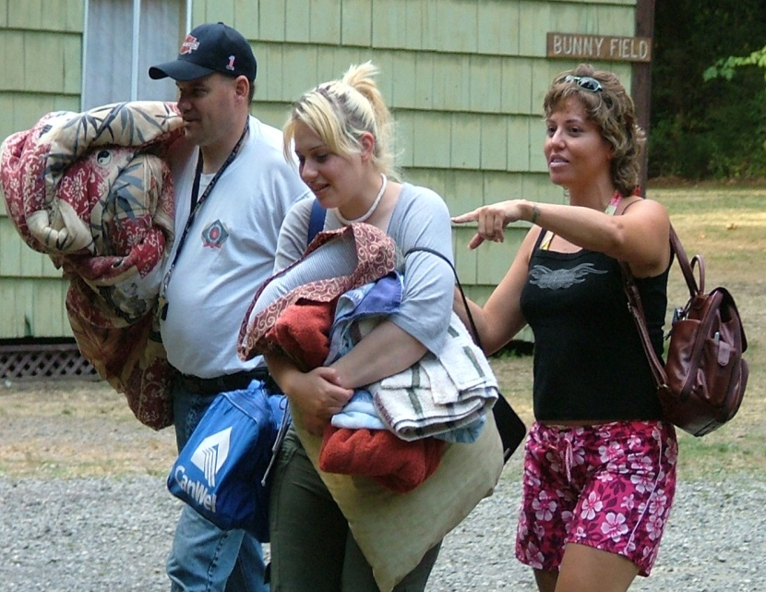
The Young and the Restless
Have a history of problem solving by running
away or getting tossed from programs.
Don’t hesitate to test out what the boundaries are.
May be addicted to alcohol and drugs
Thrive on excitement
May not hesitate to steal or sell personal property.
May exchange sex for drugs or alcohol
Cells, text messaging, chat lines and MSN are a way of life for these young folks.
Don’t learn from past mistakes.
The young women can be surprisingly violent. The women usually have limited police or court response. “They have tried to charge me 156 times and it was always thrown out. You can’t do anything to me” spoken to a Police Psychiatrist.

Slide 27
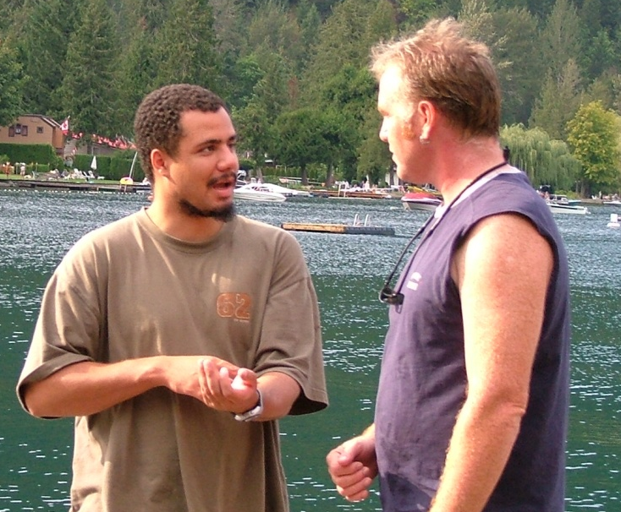
Fast Paced Response
Challenging situations quickly go from line care giver to team leader to coordinator to ED and or directly to 911- This can be self initiated. It is not uncommon for the excessive use of stimulants like tobacco alcohol to proceed a crisis.
Response must be warm and caring - assuring that all are safe and loved
Rush to the crisis but walk through the door.
Line care givers need 24/7 response if the revolving door is to be stopped.
Don’t provoke violence
Less talk, slow the pace, sit down, model cooling things down, share some tea, make few demands

Slide 28
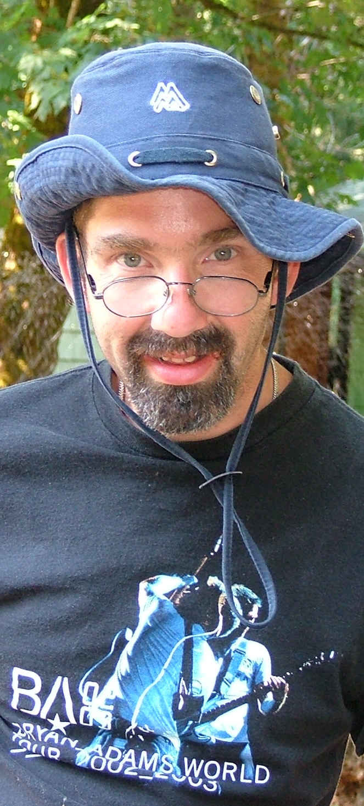
Outside Protocols
In the same evening 911, Police, hospital emergency, and mental health services may all be involved – the need for a plan and protocols is obvious
To complicate life, the above agencies have rotating staff often working 12 hours shifts and one rarely sees the same people or professionals twice.
Use appropriate generic services as required or requested but keep a line of communication open with liasion staff and remind all of protocols. Don’t abandon some one in an ambulance or hospital
Remind them that you are there to keep them feeling safe and loved. Nurture with food, words and touch

Slide 29
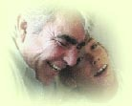
Crisis Support
Downplay the crisis. Walk in as if you are just visiting – greet with hugs
Use a tag team approach to give relief
Broaden the space for movement.
Work to reconnect the care giver.
Ignore the incident if possible – clean up and get on with life. Use the cleanup as a way of connecting.
In extremes be prepared for suicide attempts after critical incidents
Use emergency respite to avoid crisis rather than a response to crisis.

Slide 30

Time Heals
A crisis can come on fast but be over in 10-15 minutes. Provide face saving options – go for a coffee, make a phone call etc.
Don’t attach blame – tough times are part of all out lives
Use humour. Bring the energy down.
Value care givers through verbal praise, emails, team meetings and lots of hugs
In the middle of a crisis at the emergency ward it is not uncommon for the person to decide to go home.
Thank the hospital staff before heading home.
Even in a crisis it is important that everyone feel
SAFE, LOVED, ENGAGED and LOVING

Slide 31
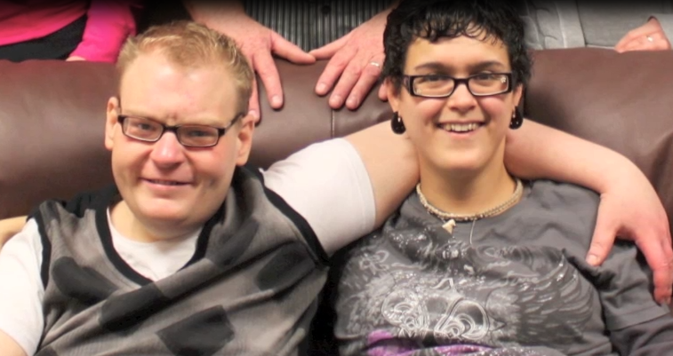
Prader-Willi Syndrome

Slide 32
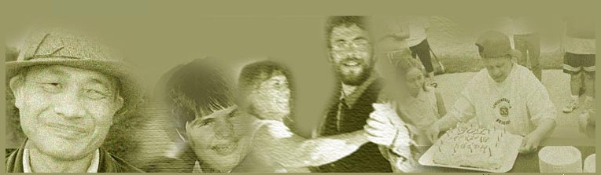
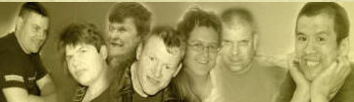
Thanks for your time
www.HomeSociety.com www.GentleTeaching.com

