Slide 1
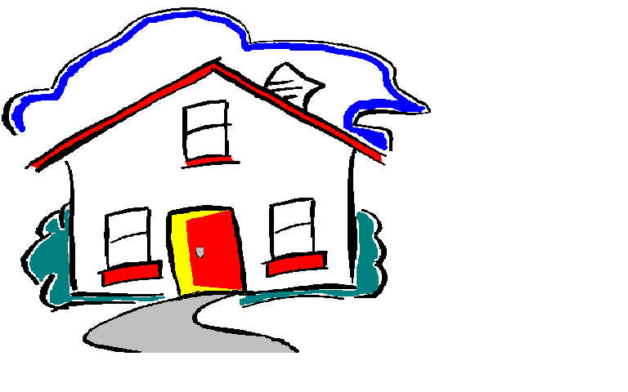
Focus on Nutrition
The HOME Society
Abbotsford, BC
Notes:
Good morning everyone, it is a pleasure to be with you this morning.

Slide 2
Focus on Nutrition
Vesanto Melina,
Registered Dietitian
Shelley Rath,
Quality Improvement Manager
HOME Society
Notes:
For this session, we have two presenters, first myself and next Shelley Rath.
Shelley Rath has coordinated the HOMES 3 year accreditation with Accreditation Canada. With HOMES, Shelley has coordinated respite and emergency support. She is a key person in the Focus on Nutrition project, and will share with you specific aspects of the program.

Slide 3
Focus on Nutrition
HOME Society
www.homesociety.com
www.gentleteaching.com
Notes:
HOME SOCIETY caregivers work within a Gentle Teaching philosophy.
The foundation of this philosophy is RELATIONSHIPS. People who are supported need to feel: Safe and Loved; with time they become Loving and Engaged, These caregivers support folks who often struggle with poor impulse control. "I need it now" is not an uncommon theme.
It is imperative that we never provoke violence, but instead always invoke peace.
Historically and across cultures, food or the "breaking of bread" has been a common theme both in community and in family. Sharing food and giving food often is an significant part of relationship. Yet it can be difficult to move to more healthy choices, as folks have often been placated with poor food choices (hamburgers, chips, pop etc.)
Because of this focus on building and maintaining relationships, it often is difficult for caregivers to say "no“, especially early on.
Caregivers need to work with the people who are supported to prepare them for challenging situations (restaurants, birthday parties.)
Here are two websites connected with the HOME Society: www.homesociety.com
www.gentleteaching.com

Slide 4
Our nutrition challenges?
Notes:
In this context, what are our nutrition challenges?

Slide 5

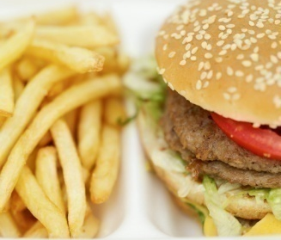
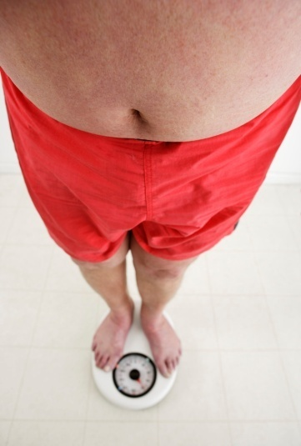
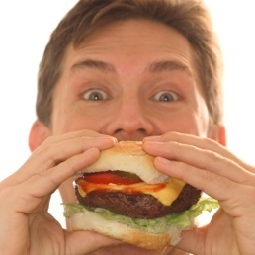


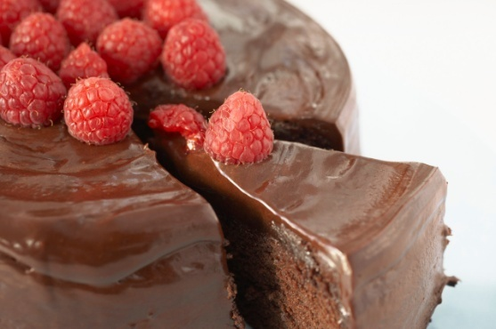
Our nutrition challenges?
Medications that lead to weight gain
Fast food everywhere
Overweight caregivers
Food as reward
Inactivity
Food fills a void
Notes:
Our nutrition challenges include:
Medications that lead to weight gain
Fast food everywhere
Overweight caregivers
Food typically used as reward, including when other approaches fail.
Inactivity
Food fills a void

Slide 6
Certain medications are linked with weight gain.
Weight gain:
is linked to appetite changes in first 3 months;
is not essential;
can be minimized by planning.
Notes:
Certain medications are linked with weight gain.
This weight gain:
is linked to appetite changes that occur within first 3 months (and then become habitual);
Yet this is not essential;
and the excessive weight gain can be minimized by planning.

Slide 7
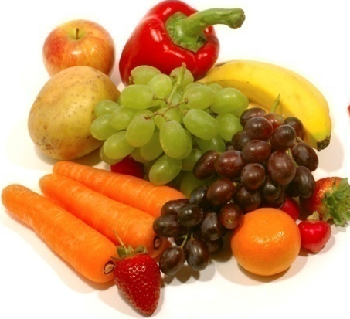
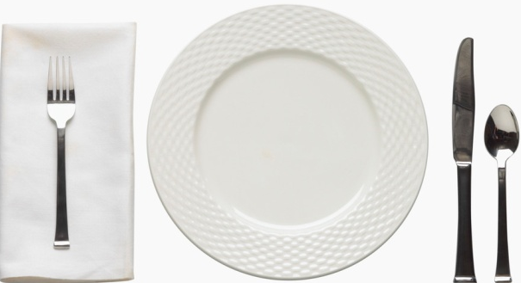
To prevent or minimize weight gain
Encourage “free” foods (vegetables, calorie-free beverages, butterless popcorn).
Use fruit instead of sweets.
Limit portions.
If pattern is 3 meals + ~3 snacks,
make meals small (especially portions of fatty foods).
Use small plates.
Have people supported and caregivers
take part in activity programs.
Notes:
To prevent or minimize weight gain, here are some keys:
Encourage “free” foods (vegetables, calorie-free beverages, butterless popcorn).
Use fruit instead of sweets.
Limit portions.
If pattern is 3 meals + ~3 snacks, make meals small (especially portions of fatty foods).
Use small plates.
Have people supported and caregivers take part in activity programs.

Slide 8
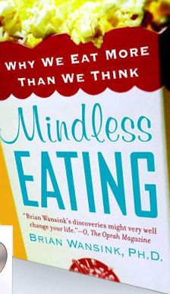
Mindless EATING
By Brian Wansink (of Cornell)
(Why We Eat More Than We Think)
Will we consume more soup when the bowl is bottomless?
www.mindlesseating.org
Notes:
The work of Cornell University’s Dr. Brian Wansink came to our attention. Some of his cleverly designed studies shed light on overeating in ways that can help us eliminate some of the unconscious or mindless overeating of others and of ourselves. (Website: http://mindlesseating.org) We have become aware that the size of a package or portion served can increase consumption. Wansink took this further. One question he explored was: “Exactly how much more soup will people consume when their bowl is bottomless?” and “If they eat more, will they feel fuller?” Adults thought they were participating in a study about bowl colour. They were asked not to move the bowls.
They seated themselves in front of one of 4 bowls of tomato soup at a restaurant-style table in which (describe with hand gestures) two of four bowls slowly and imperceptibly refilled as their contents were consumed. Below the tablecloth, tubing allowed the soup to seep into the bottom of 2 bowls; the 18-oz bowls took 20 minutes to refill.
After 20 minutes, they were thanked & given a questionnaire asking them a number of irrelevant questions plus how sated they were, whether they generally try to eat until their bowl is empty and to estimate how much they believed they ate (in ounces and in calories).

Slide 9
Will we consume more soup when the bowl is bottomless?
Study: Yes, 73% more.
Yet soup eaters did not believe they had consumed more, nor feel more sated.
Wansink B.
Bottomless bowls: why visual cues of portion size may influence intake.
Obes Res. 2005 Jan;13(1):93-100.
Notes:
Participants who unknowingly ate from imperceptibly-refilling bowls ate 73% more than those eating from normal bowls.
Yet despite consuming 73% more, they did not believe they had consumed more, nor did they perceive themselves to be more sated or full than those eating from normal bowls.
It seems that people use their eyes to count calories and not the sensitivity to amount consumed.
Pre-portioning meals can reduce caloric intake, rather than family style service where someone’s plate is automatically refilled.
Wansink B. Bottomless bowls: why visual cues of portion size may influence intake.
Obes Res. 2005 Jan;13(1):93-100.

Slide 10
Mindless EATING
By Brian Wansink (of Cornell)
(Why We Eat More Than We Think)
How much more popcorn do
we eat when given a large tub
of popcorn (over medium)?
www.mindlesseating.org
Notes:
In another study, moviegoers in Philadelphia were randomly given either a large or medium container of popcorn
Furthermore, in both sizes, some bags held fresh popcorn, others stale (14 days old).

Slide 11
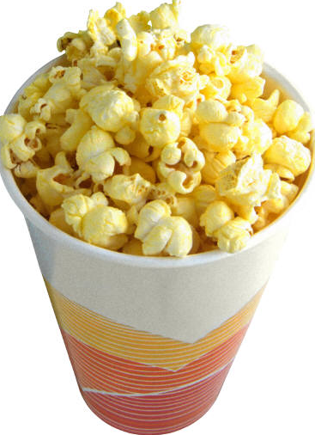
How much more popcorn do
we eat when given a large tub
of popcorn (over medium)?
45% more.
Even when stale, 35% more.
Wansink B, Kim J.
Bad popcorn in big buckets: portion size can influence intake as much as taste.
J Nutr Educ Behav. 2005 Sep-Oct;37(5):242-5.
Notes:
People given large containers of popcorn ate 45% more.
Even when stale (and rated “stale”, “soggy” or “terrible”, they ate 35% more.
This was also borne out with snacks at Superbowl parties, and dinner entrees.
We think people will eat more of what they like. Yet when there’s plenty, they (or we) eat plenty.
Portion size and package can affect consumption of tasty foods, as well as ones that are not as tasty. Even it a person does not particularly care for a food, "grazing" from a large bowl will cause him or her to eat more.
It may be possible to increase the consumption of less preferred healthful foods (such as raw veggies at mealtime or as TV snacks) by serving them in larger bowls.
In contrast, a smaller bowl can influence us to think we may had enough.
Wansink B, Kim J.
Bad popcorn in big buckets: portion size can influence intake as much as taste.
J Nutr Educ Behav. 2005 Sep-Oct;37(5):242-5.

Slide 12

How much more
candy will we eat
when they are close rather than far away?
www.mindlesseating.org
Notes:
How much more candy will we eat when they are close rather than far away?
This study about convenience and visibility involved chocolate candies.
Sixteen office workers in a university setting (ten female, 6 male; median age 43 years)

Slide 13
How much more
candy will we eat
when they are close rather than far away?
2 meters away: 3
In drawer: 6
On desk top: 9
Wansink, B et al.
The office candy dish: proximity's influence on estimated and actual consumption.
Int J Obes (Lond). 2006 May;30(5):871-5.
Notes:
When chocolates were placed 2 meters away, office workers ate: 3
In drawer where it was convenient but not visible they ate: 6
On desk top where it was visible and convenient : 9, three times as much.
Wansink says: “What makes the candy dish nutritionally dangerous might bring the fruit bowl back in vogue.” This also could be a plus when it comes to placing a platter of veggies.
Wansink, B et al.
The office candy dish: proximity's influence on estimated and actual consumption.
Int J Obes (Lond). 2006 May;30(5):871-5.

Slide 14
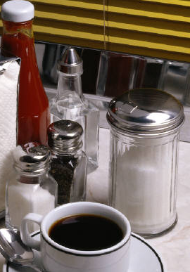
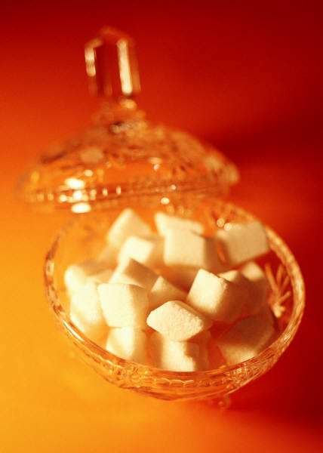
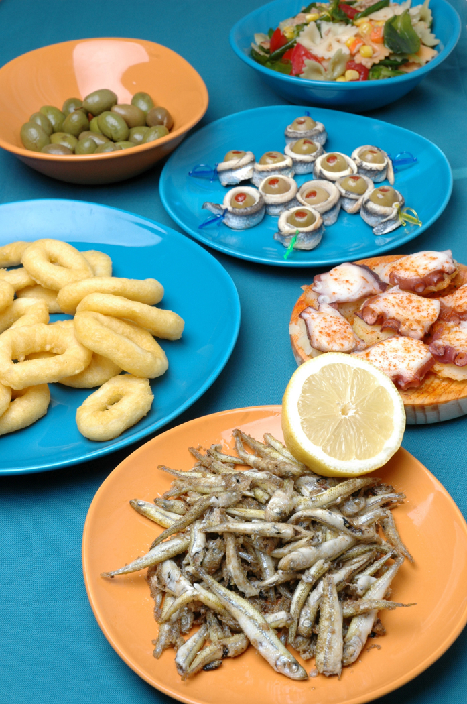
Unlimited access
to condiments
can lead to
weight gain.
Notes:
In combatting overweight and obesity in people with mental disabilities, a Toronto hospital removed the condiment cart and beverage vending machines.
It can help to put out exactly the desired number of cubes of sugar, or portions of ketchup, rather than allowing unlimited access. 5 sugar cubes is 50 calories.

Slide 15
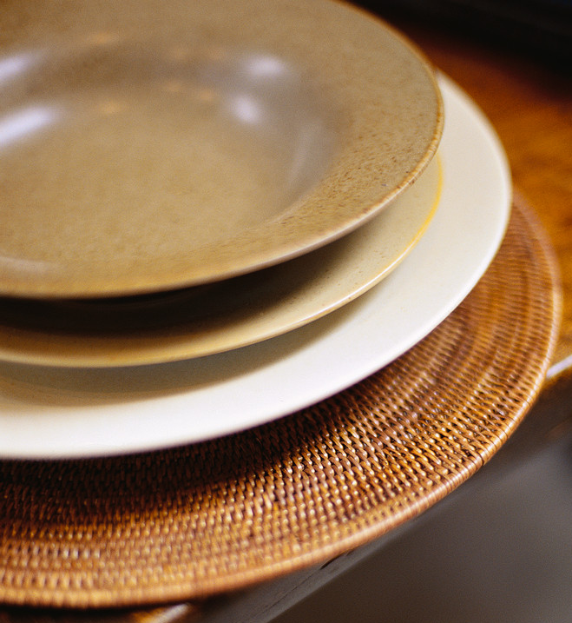
Do we eat a more or less when we use a
different size plate?
Notes:
Do we eat a different amount when we use a different size plate?

Slide 16

Notes:
In one study, people were offered a simple pasta lunch and served themselves. Before being seated, they had to set down their plate, as it happened on a hidden scale. A “waiter” came along and showed them to their seat, saying he would bring over their plate.
In bringing it, he coughed on their plate, apologized, and then gave them a second plate that was either larger or smaller than the first, allowing them to self serve again.

Slide 17
People ate 31% more with
a larger plate.
Notes:
In whatever sequence, people ate 31% more with a larger plate.
A few other examples might encourage us to consider sizes of plates, bowls, glassware, and utensils purchased for people we support and perhaps for ourselves.
Teenagers poured 88% more juice or soda into short wide glasses than into tall narrower glasses that held the same volume, yet they thought they poured less. With bartenders, the results were similar.
Cafeteria studies show that people ate more ice cream when the lid of an ice cream cooler was left open than when it was closed
(68), that they drank more milk when the milk dispenser was placed close to the dining area (60), and that they drank more water when a water pitcher was on their table than when it was further away.
People nutrition experts who were randomly given 17- or 34- ounce bowls dished out and consumed 31% more ice cream when given the larger bowls without being aware of it. Their servings increased by 14.5% when they were given a bigger spoon.
Most of us think we’re too smart to be influenced by candy dishes, television, or the shape of a glass. Yet it seems that most of us don’t overeat because we’re hungry. We overeat to deal with feelings or as a distraction; because of ease and convenience; plate, bowl, and cup size; advertising, brand names, and packaging; and visibility.

Slide 18
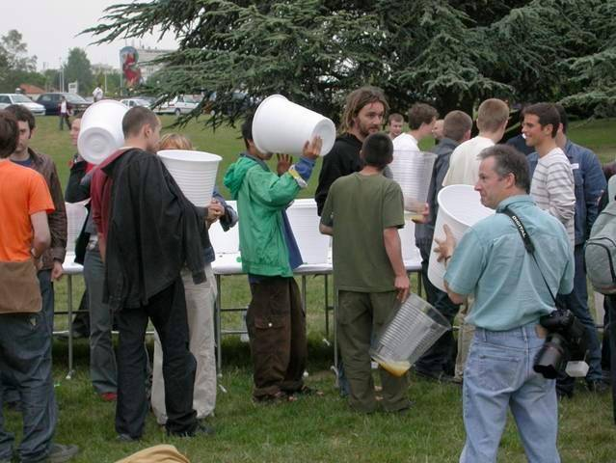
Notes:
We were using this cup size, but we’ve had to change our ways.

Slide 19
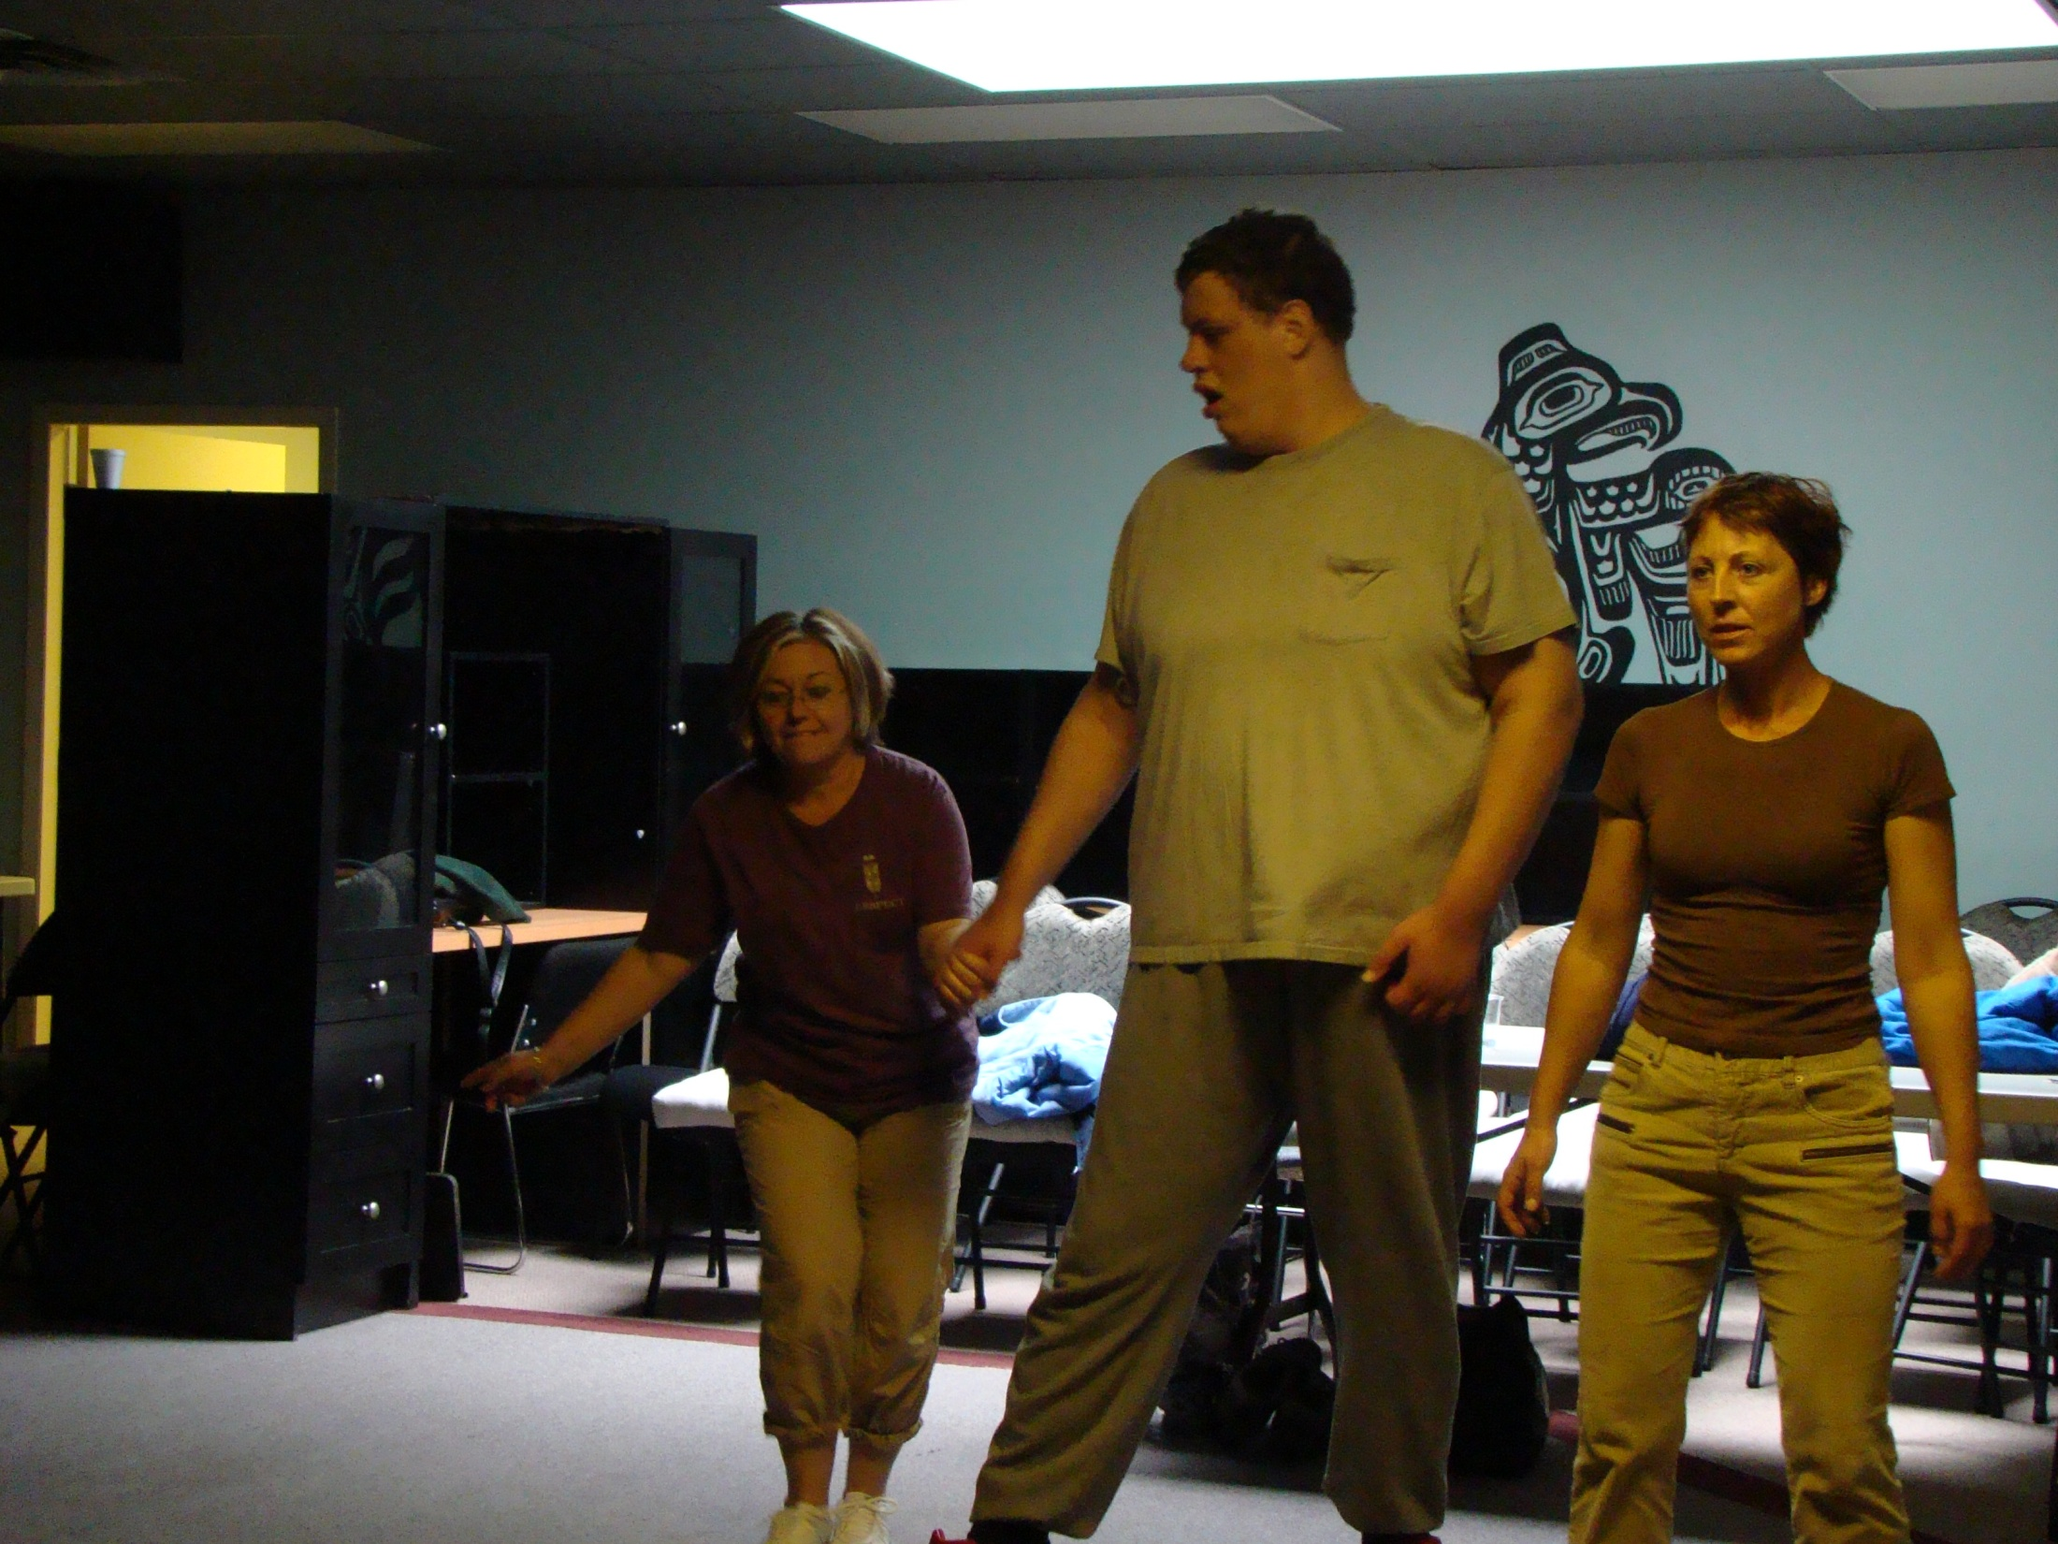
Notes:
Here is Travis taking part in HOMES Focus on Fitness program. It’s in his best interests, for health and quality of life, to keep his weight within reasonable limited.

Slide 20
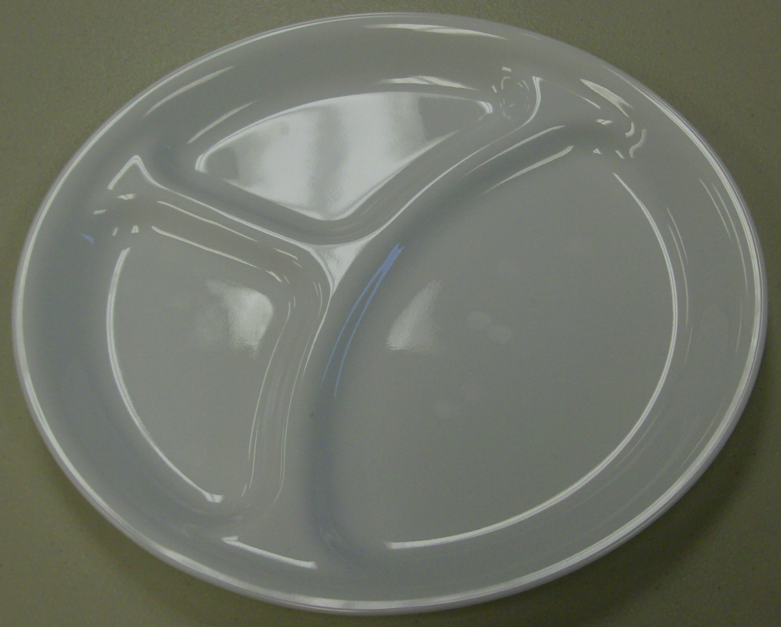
Notes:
His caregivers have taken to using sectioned plates to clarify portioning for the various parts of the meal: higher protein foods, carbohydrates, and vegetables or salad.

Slide 21
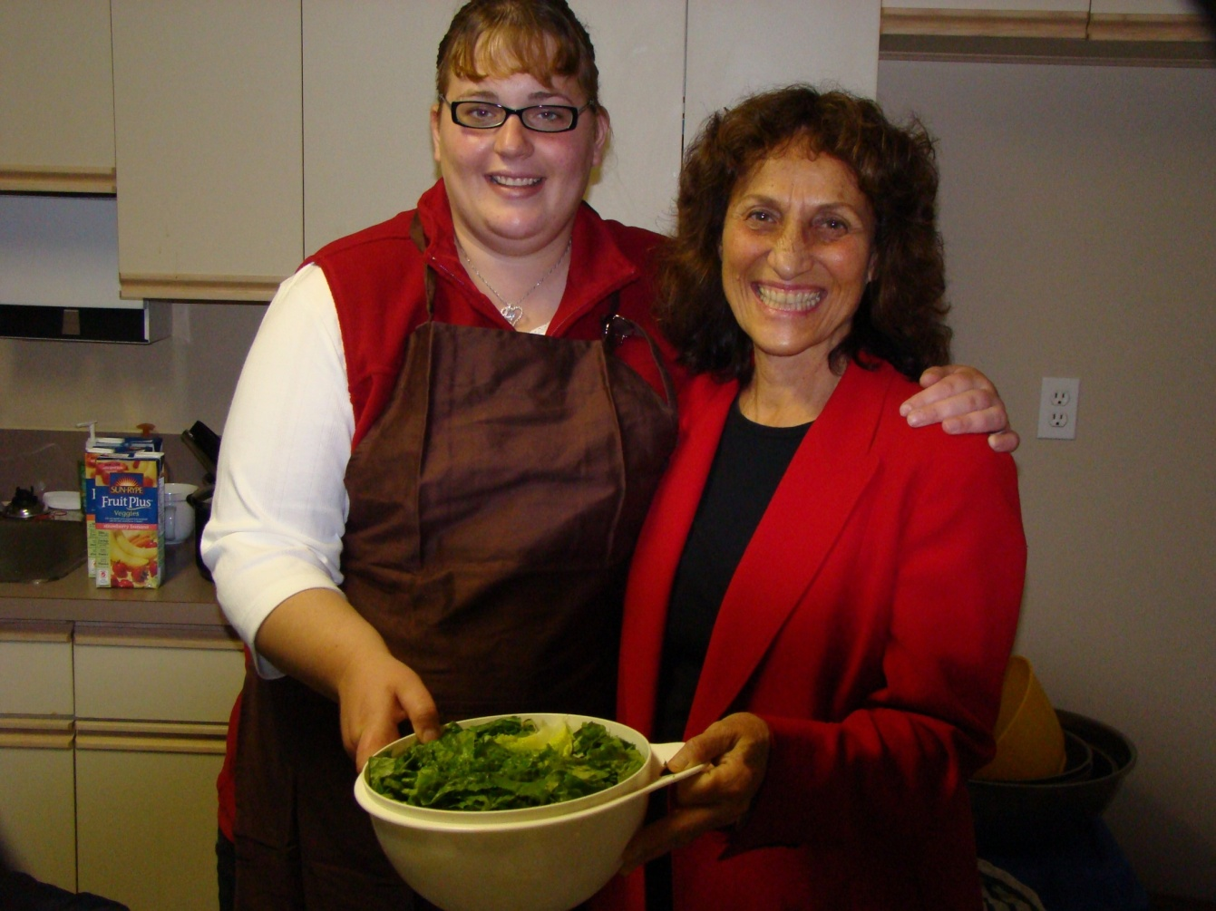
Sharing in preparation
brings
a new relationship with food.
Notes:
Sharing in preparation brings a new relationship with food and can encourage an interest in healthful foods.

Slide 22
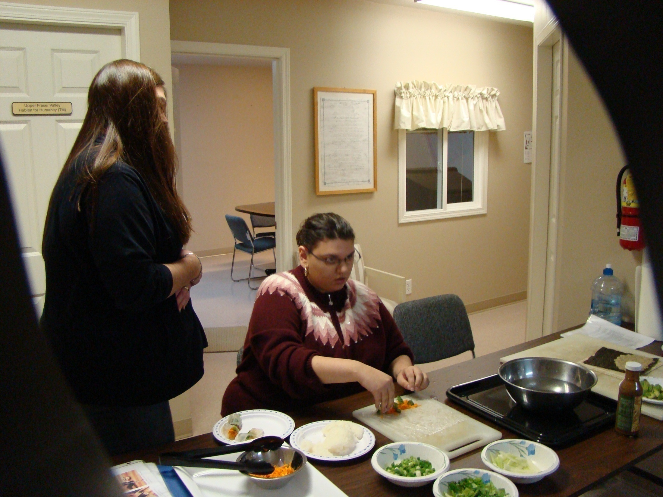
Notes:
It can be fun to try something new (such as these vegetable wraps, with sauces), and have everyone make her or his own portion.

Slide 23
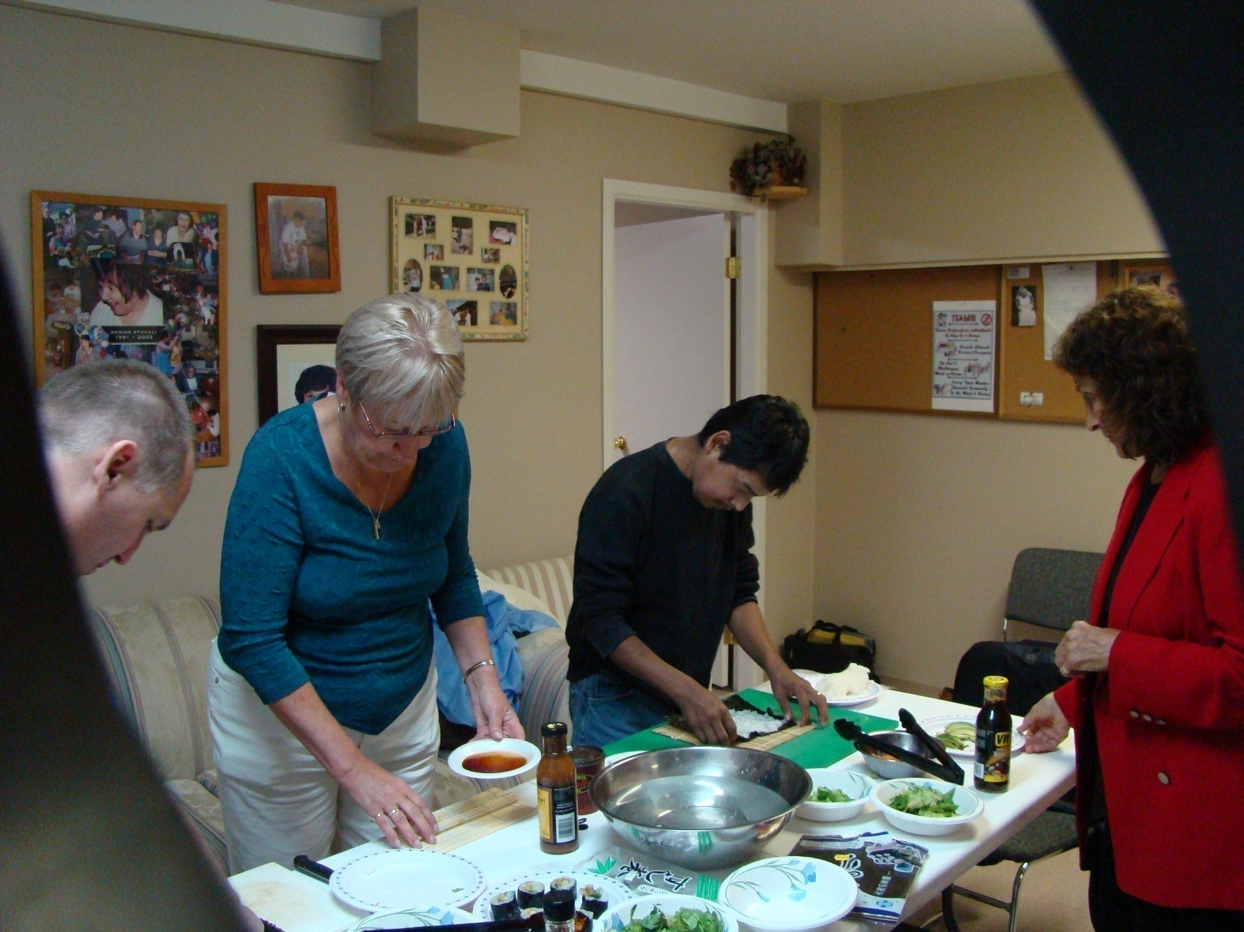
Notes:
These people are making nori rolls, with vegetables.

Slide 24
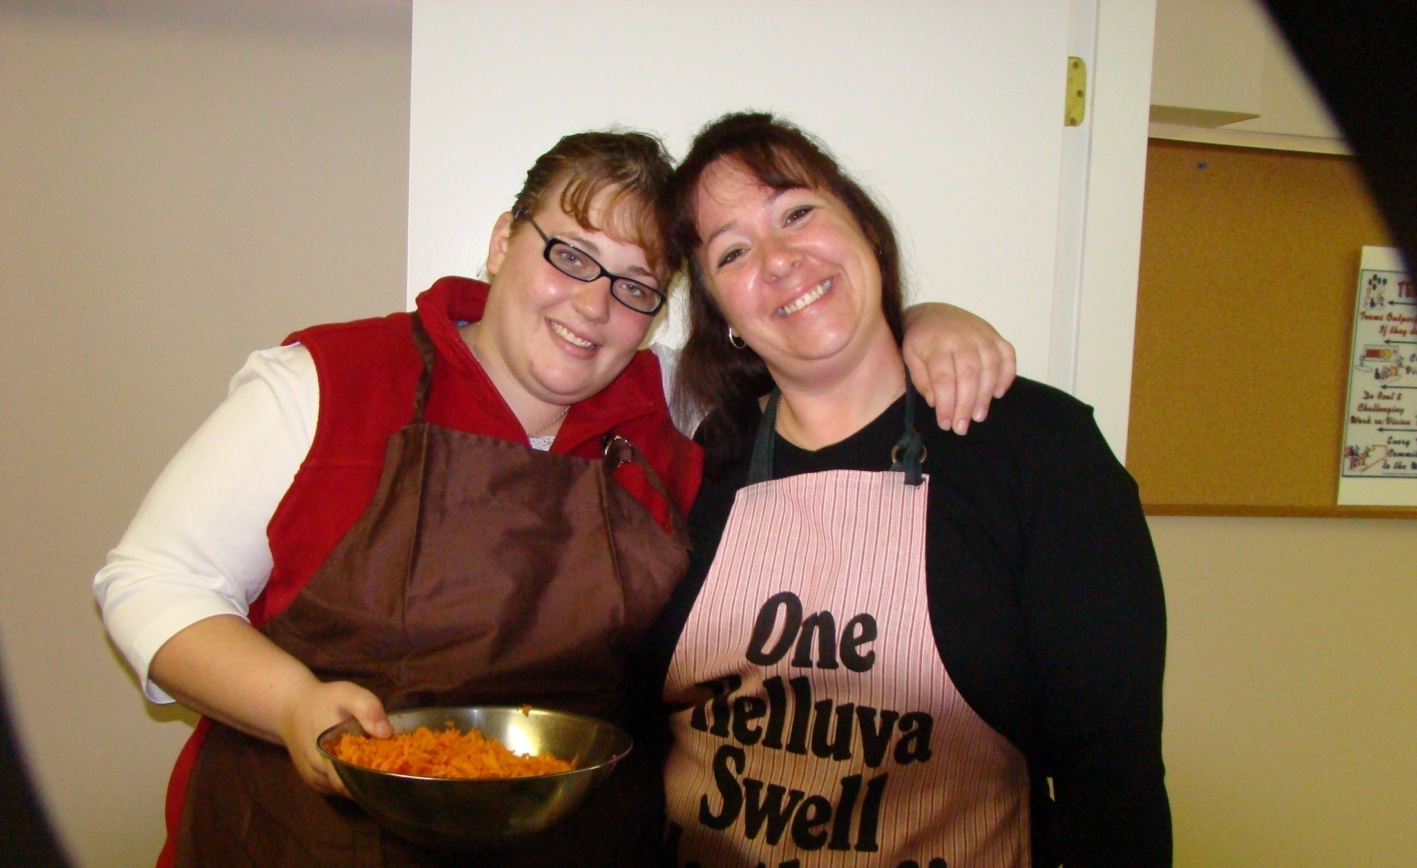
Caregiver companionship: a key for good nutrition
Notes:
Caregiver companionship can be a key for good nutrition.

Slide 25
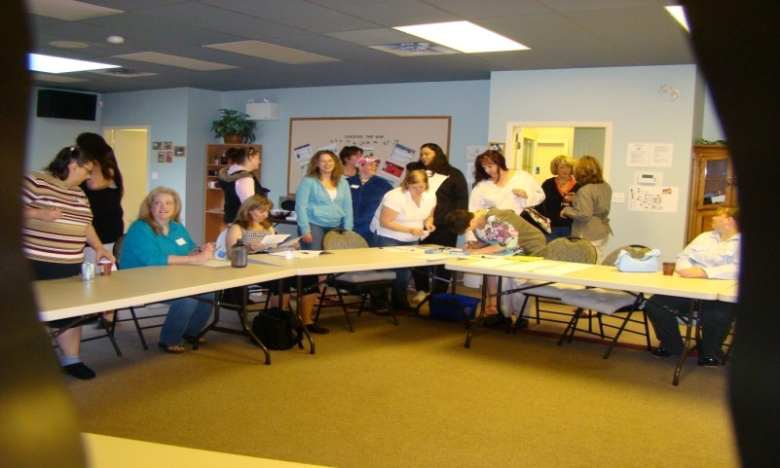
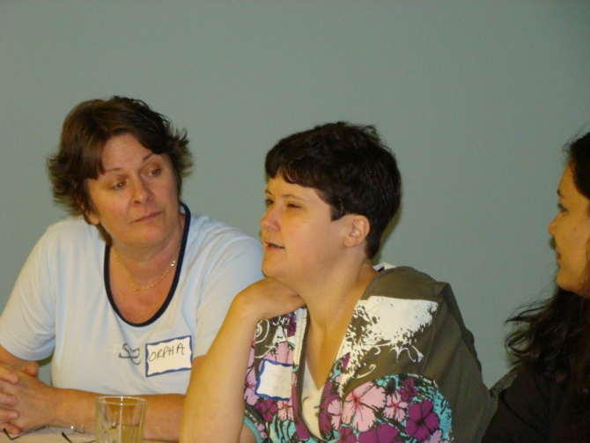
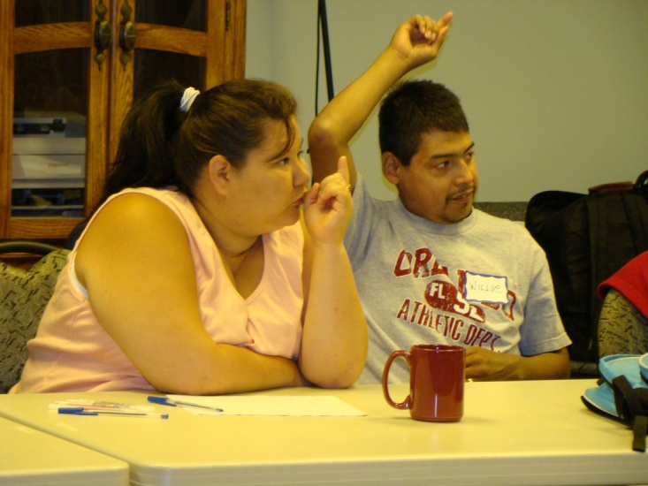
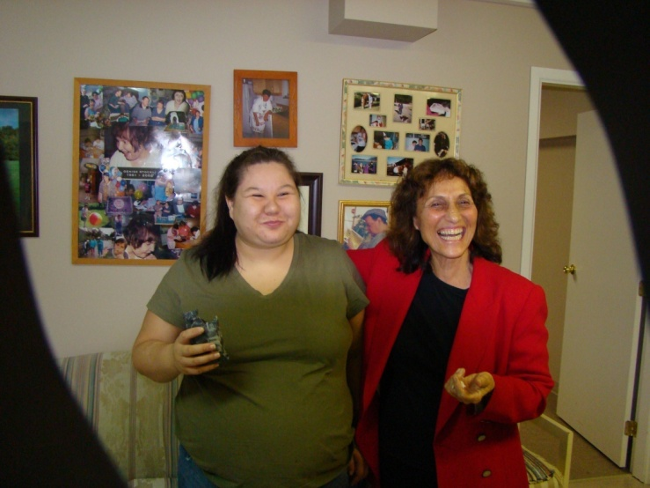
Learn & Share Nutrition Ideas
Notes:
At HOMES, the people supported have learned about nutrition and also share with their caregivers nutrition ideas, and Shelley will tell you more about that.

Slide 26
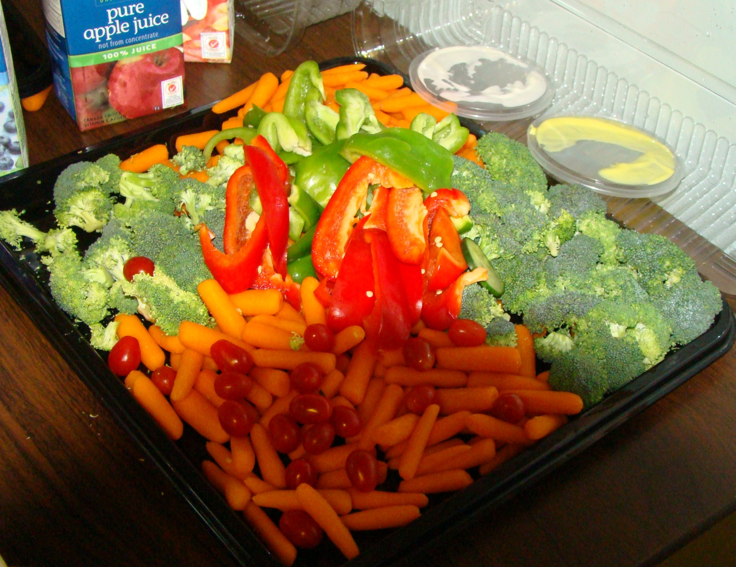
Nutrition Breaks
Notes:
There have been some changes in what is served at events.

Slide 27
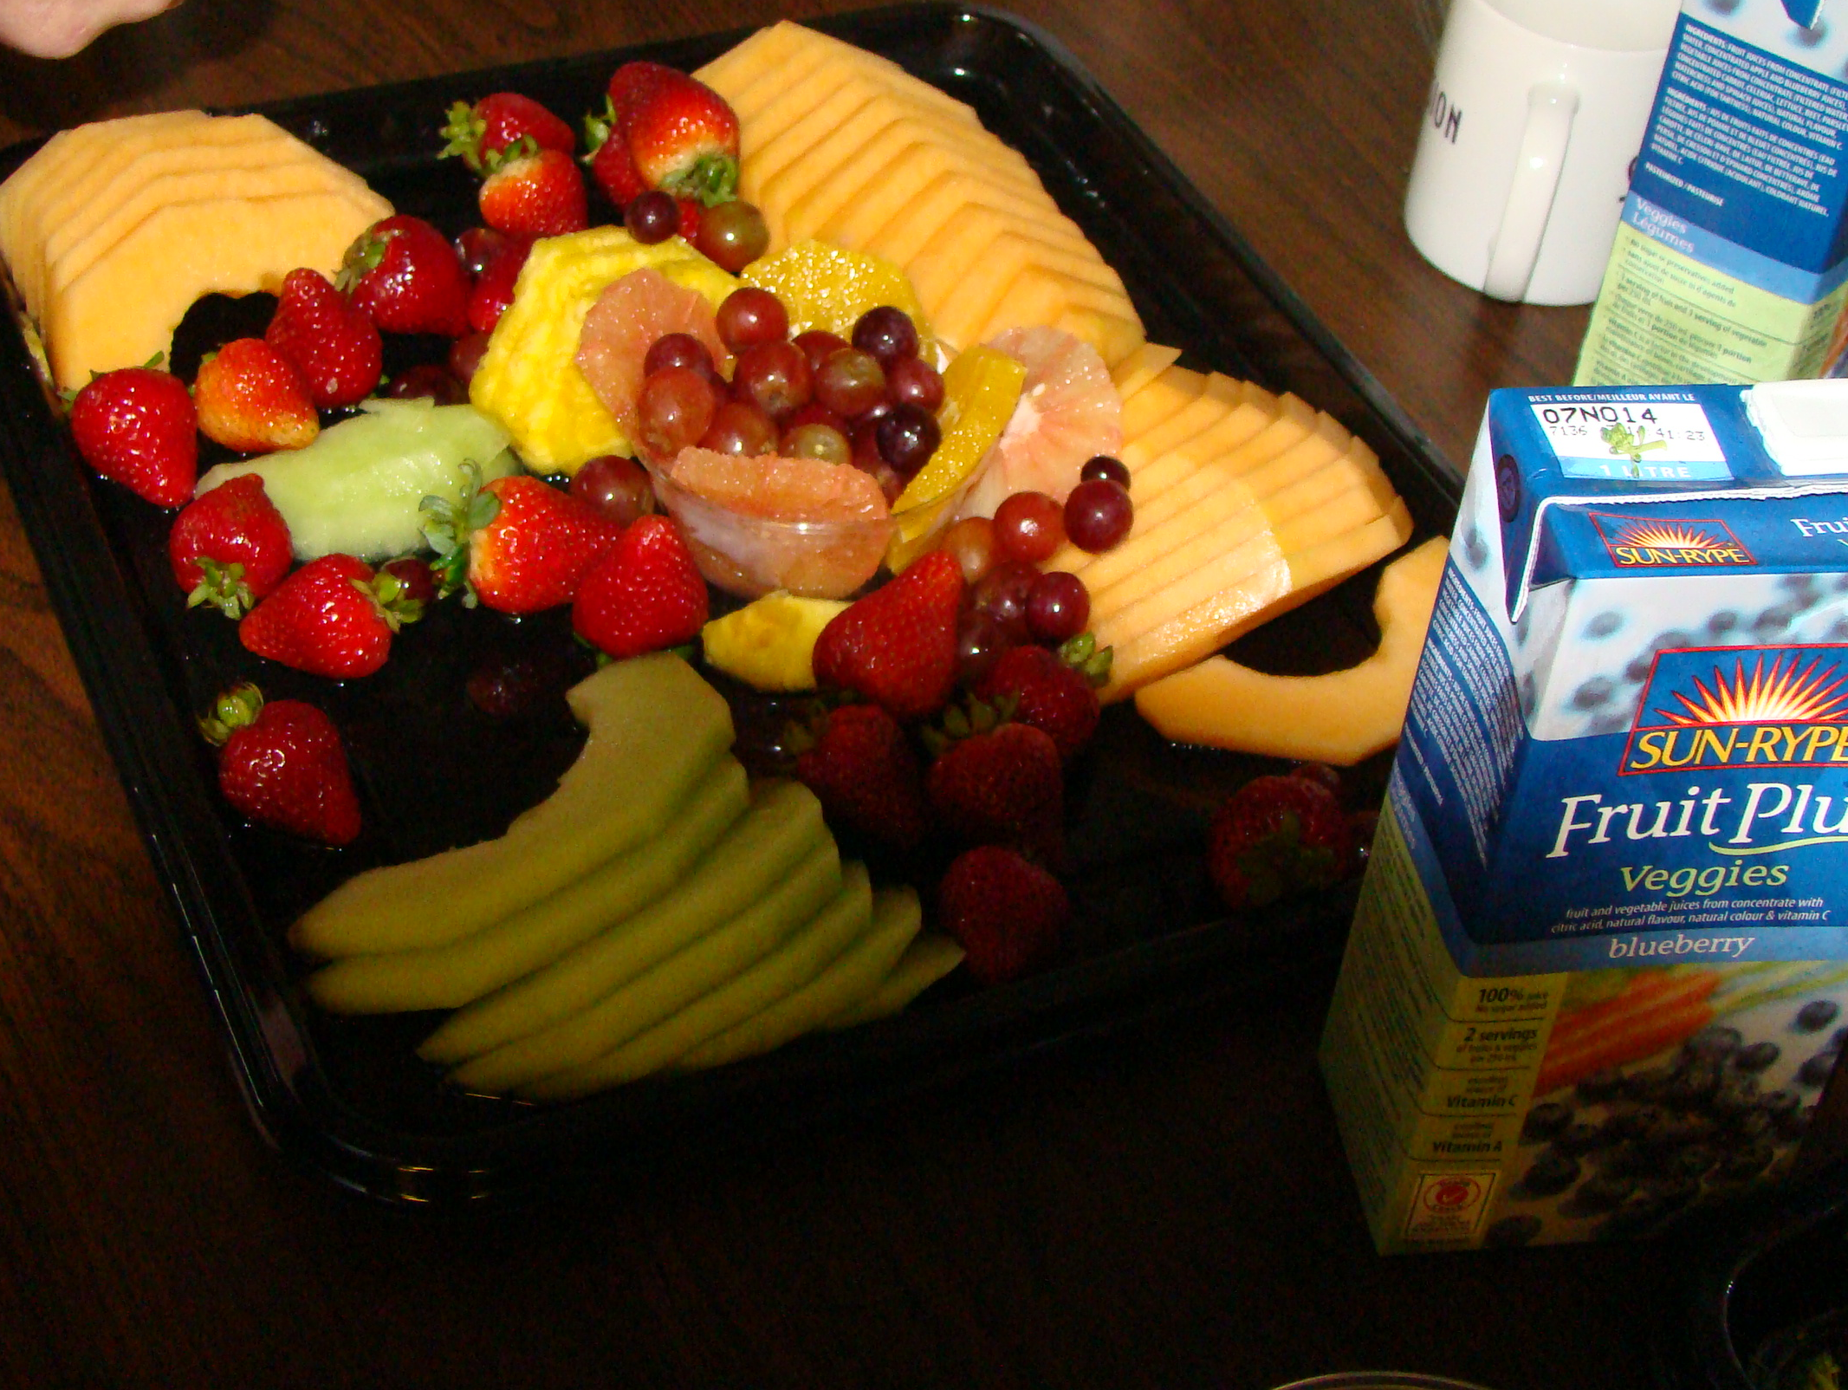
Learn & Share Nutrition Ideas

Slide 28
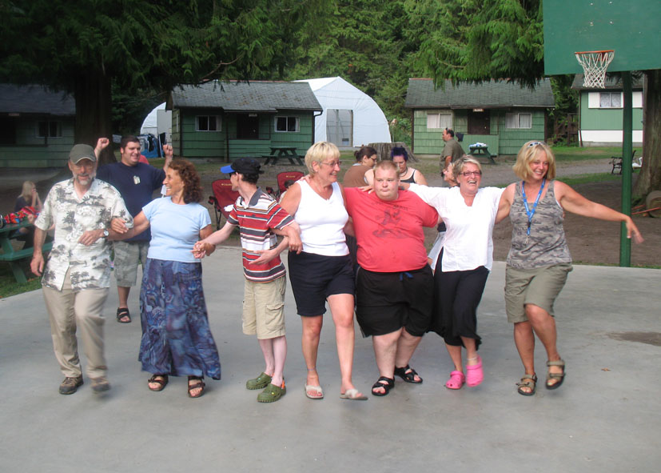
Notes:
Along with Focus on Nutrition is Focus on Fitness. Here are caregivers and people supported at Cultus Lake summer camp, including director Cam Doré at the left.

Slide 29
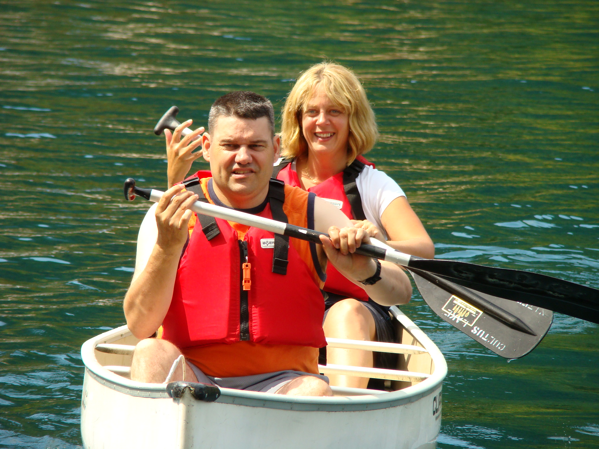

Slide 30
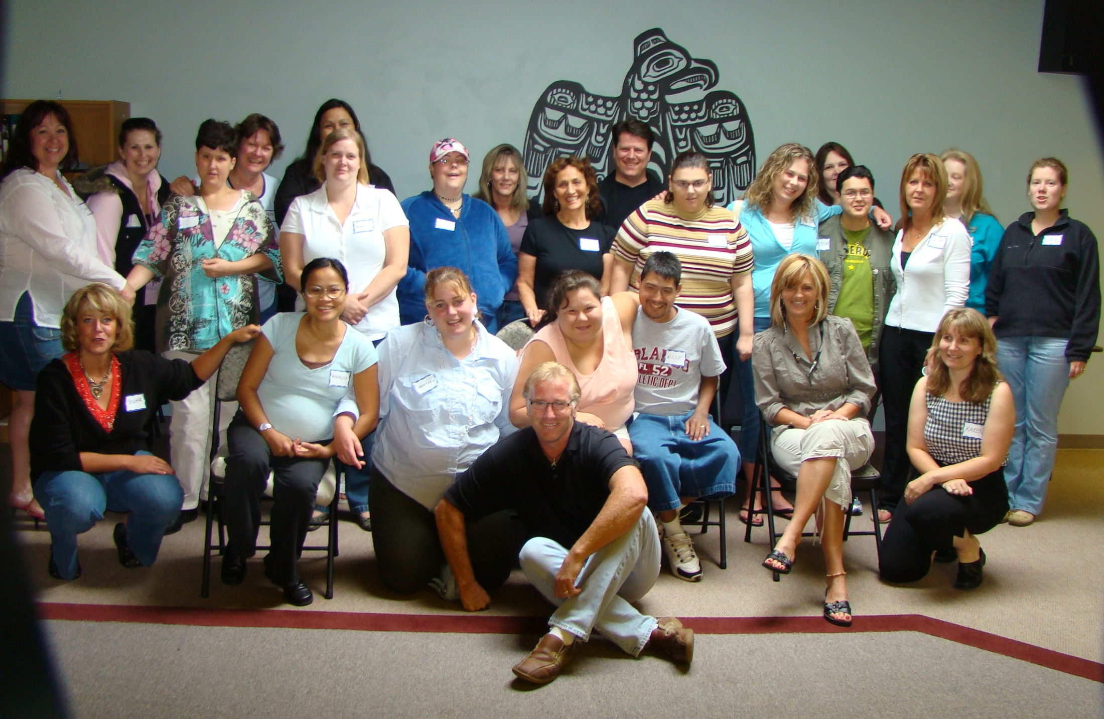
Notes:
Here are some HOMES folk.

Slide 31
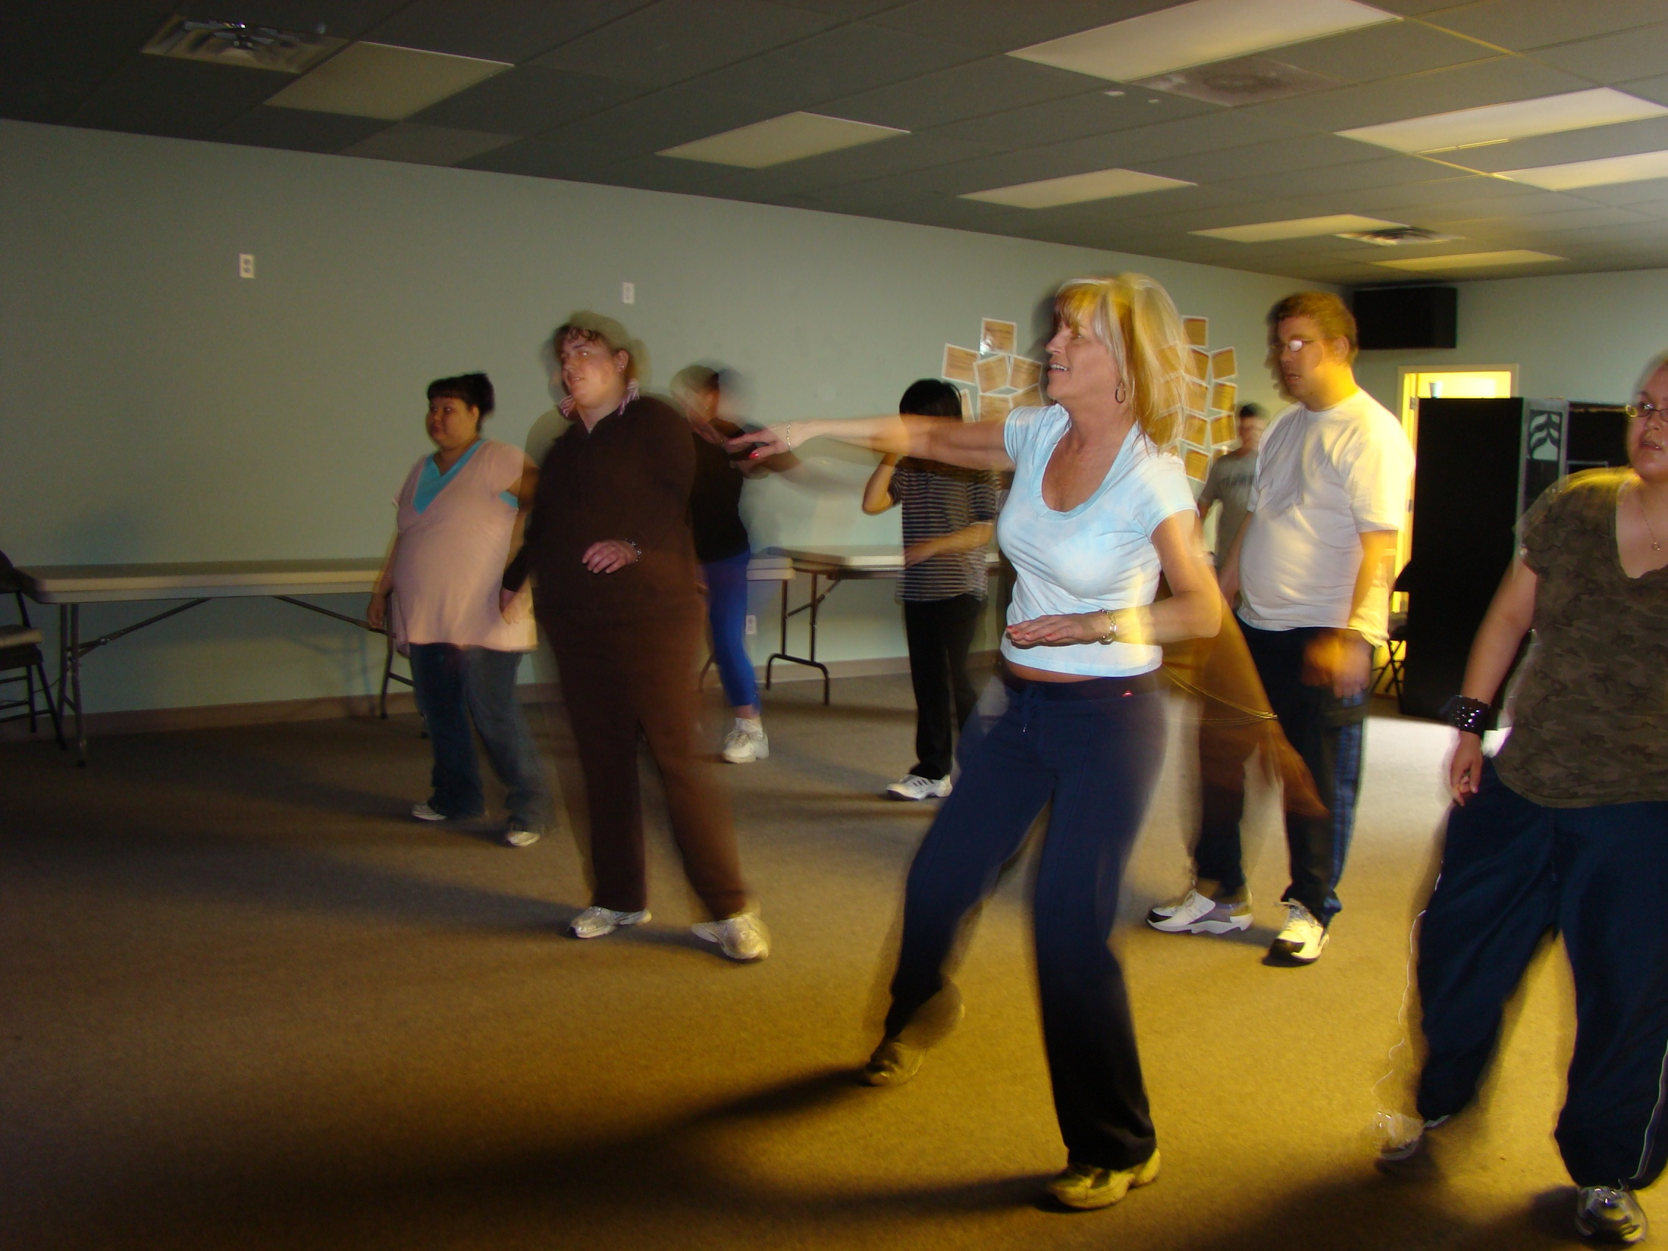
Notes:
And we will now turn the presentation over to Shelley Rath.

