Slide 1
A Culture of Gentleness
Cam Dore
Executive Director
H.O.M.E. Society
(Healthy Opportunities for Meaningful Experience Society)

Slide 2

A Canadian perspective
The HOME Society
Why a culture of Gentleness is good from an administrator’s view
  Goal of Gentle Teaching is companionship
  Creates an atmosphere of mutual respect and readiness to solve issues together
  Creates a connection to those supported and therefore a willingness to stretch and not give up when things get tough

Slide 3
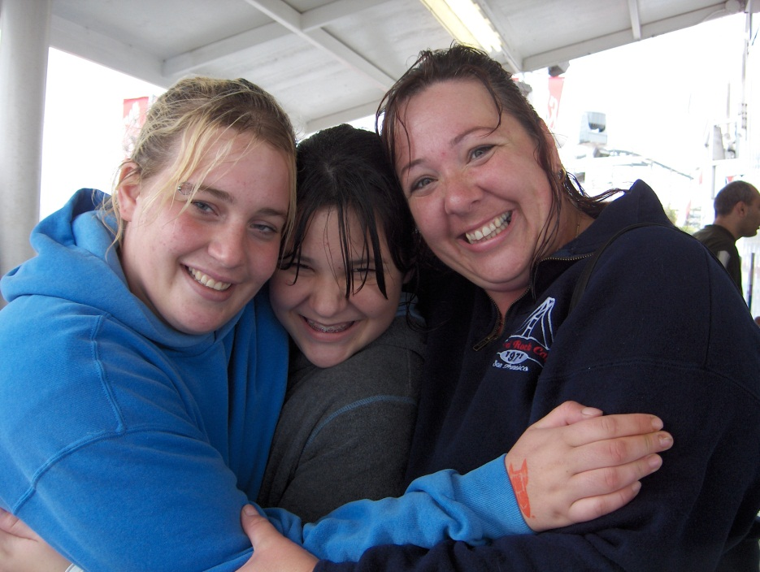
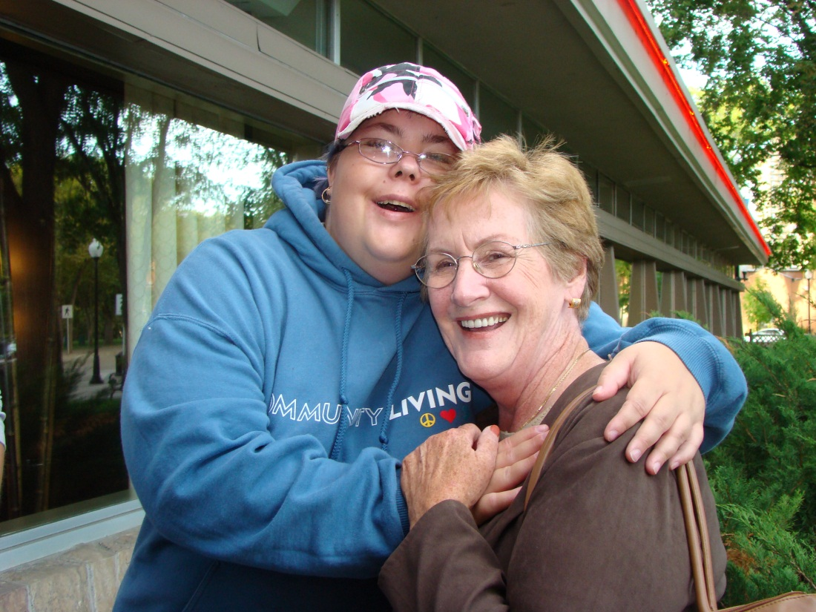
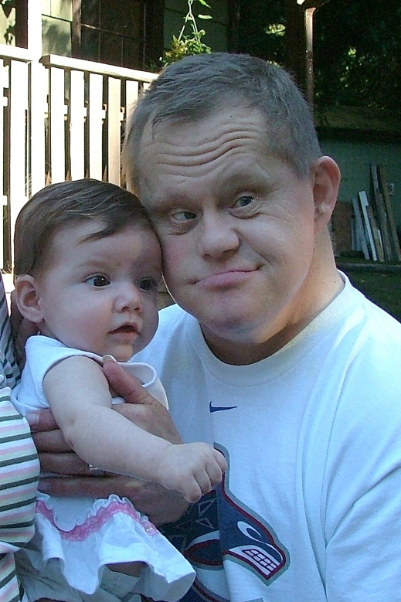
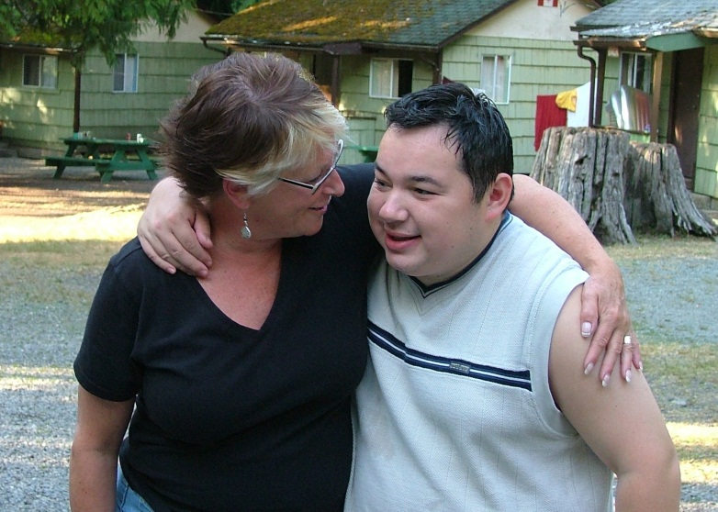
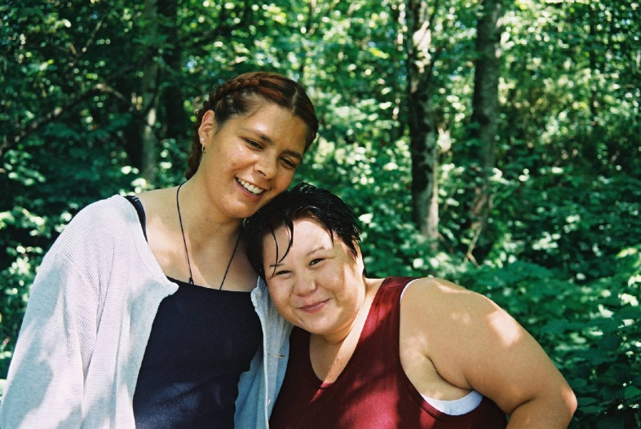
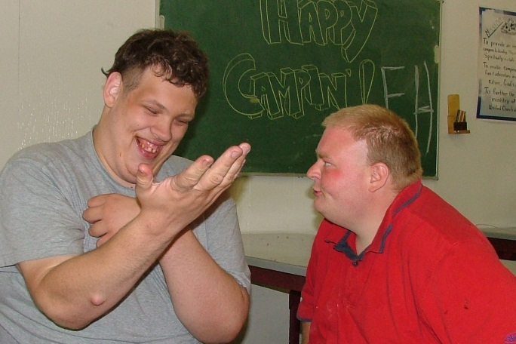
A Culture of
Gentleness

Slide 4
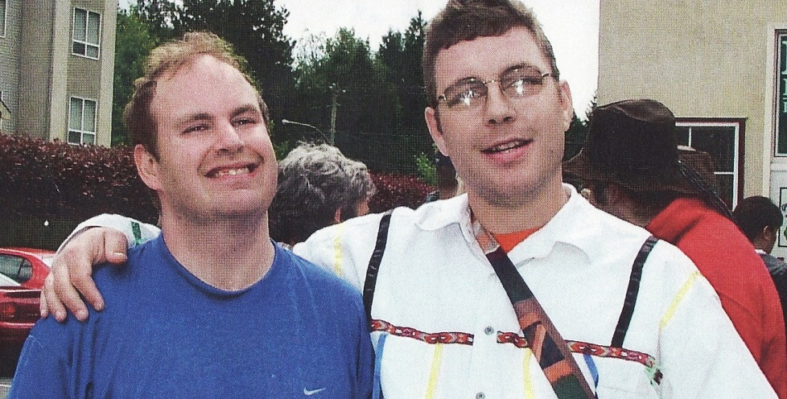
Why a Culture of Gentleness is good from an administrator’s view (continued)
  Focus is on a Culture of Life
  The central purpose of our presence in the lives
  of others is to teach, nurture and sustain the experience of connectedness, companionship and community
  Gentle Teaching and the focus on a Culture of Life works for those supported, care givers, managers and our families

Slide 5
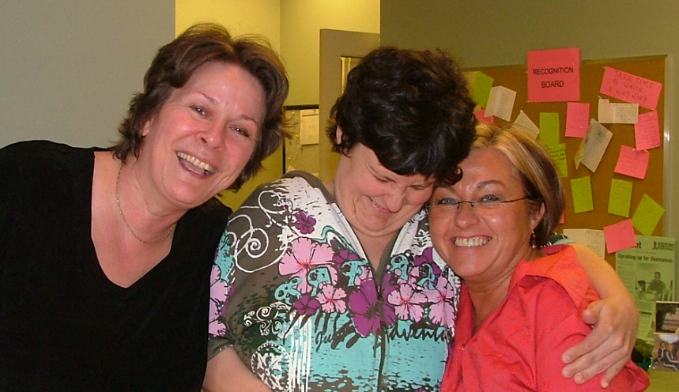
Integrating a Culture of
Gentleness
Unconditional love as the central care giving and cultural phenomenon requires:
  Movement away from individualism and toward companionship and community;
  Movement away from independence and toward interdependence;
  A focus on inner healing rather than behavioural change
  A focus on the total acceptance of each person

Slide 6
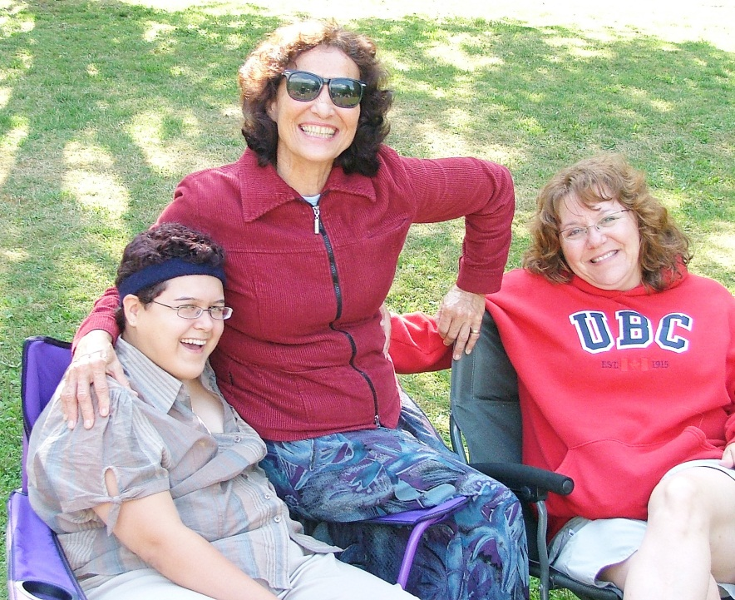
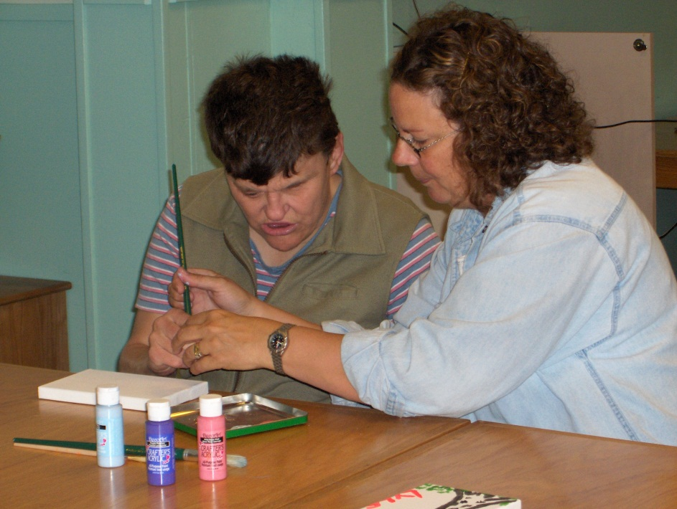


Integrating a Culture of Gentleness into an Agency
  Begin with Human Rights
Justice based:
Non Violent:
Liberation Based:
Freedom from harm:
Freedom from restraints and seclusion:
Freedom of movement:
Freedom from punishment

Slide 7
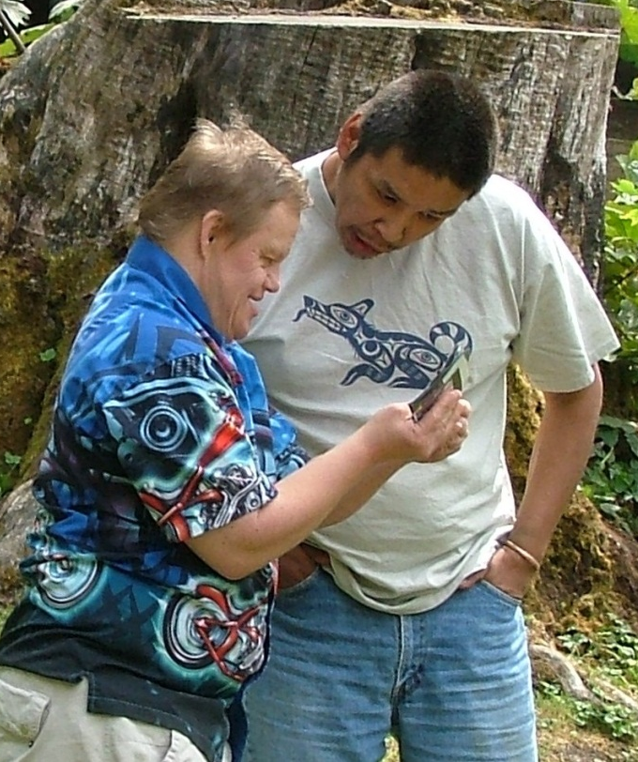
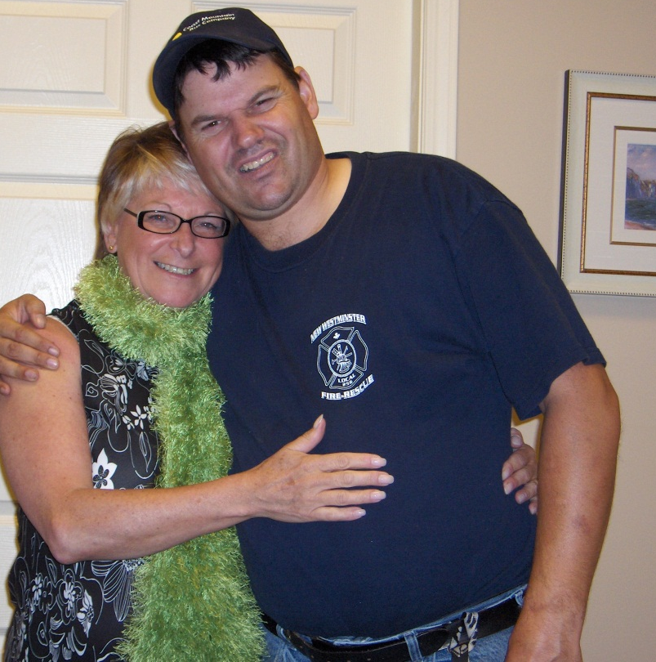
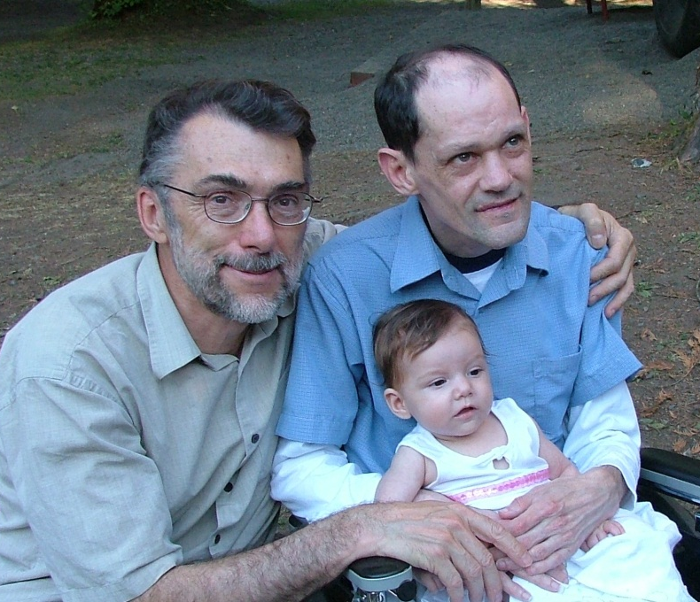
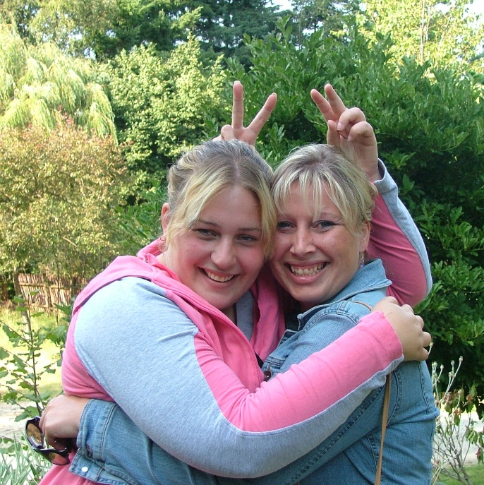
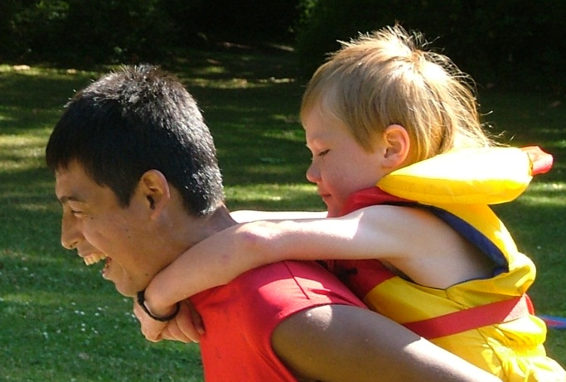
A Culture of
Gentleness

Slide 8
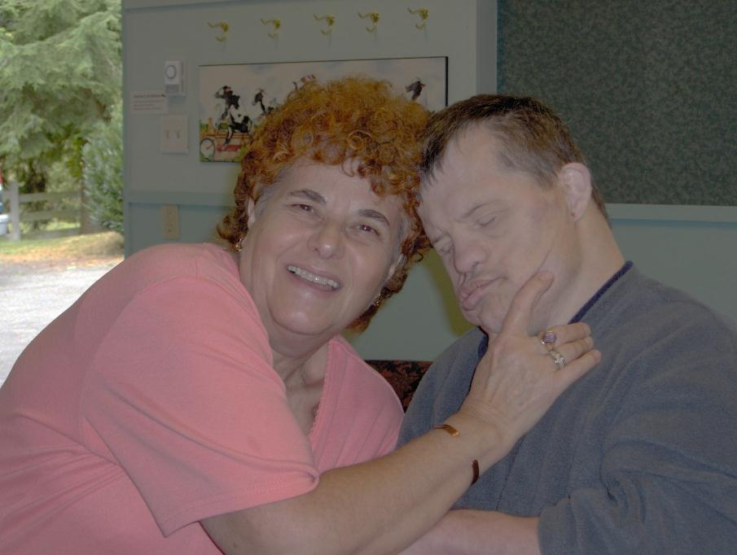
Economic Impact of a Culture
Gentleness
Decreased staff turnover
  When care givers feel safe and loved they recruit others rather than leave
  Despite a unionized setting it has been over 4 years since the last grievance
  Open door policy means care givers can drop by or email and get a resolution of issues

Slide 9
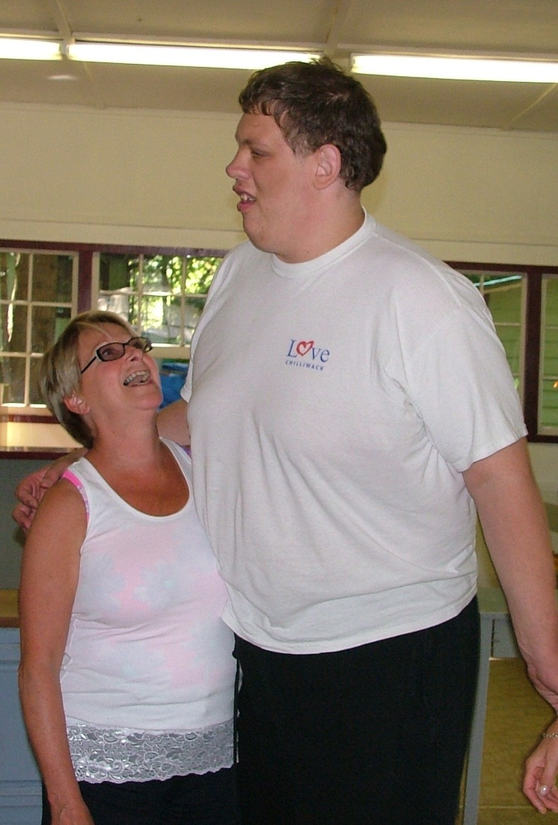
Economic Impact of a Culture
Gentleness
Decreased insurance liability
  No liability claims in 16 years
  Very little damage to homes
  Fleet vehicle insurance has 54% discount
  WCB (Work related compensation) is stable and dropping

Slide 10
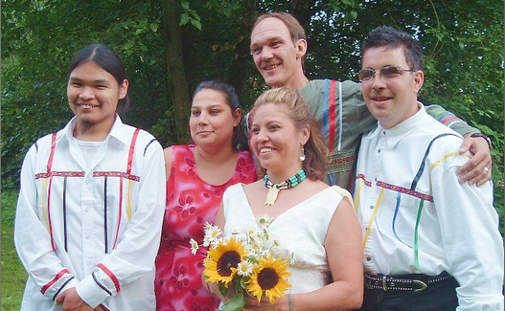
Economic Impact of a Culture
Gentleness
Increased Morale
  Sharing the responsibility for any failures
  Learn together from failures and successes
  Kitchen table discussions with everyone present
  Meet with care givers to problem solve, encourage, and praise
  Encourage management to lead by example
  Care giver morale is one of the most important ingredients for a successful living arrangement

Slide 11
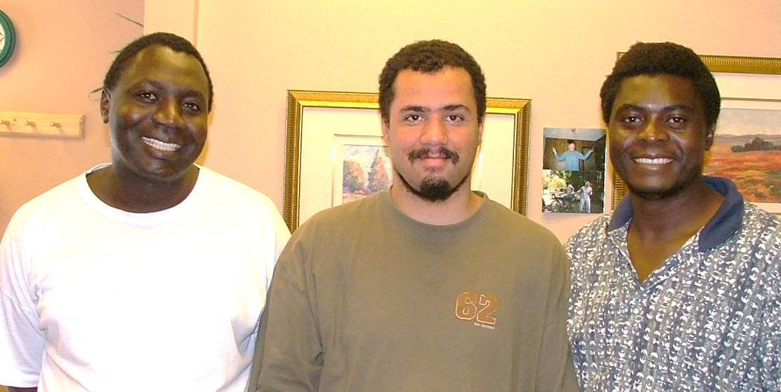
Economic Impact of a Culture
Gentleness
Increased Community Inclusion - The administrator’s central role is to enable, facilitate, and nurture this connectedness and interdependence through:
Defining companionship and community as the central purpose of the agency and community inclusion and self-determination as natural results of this
Reviewing mission statements to include a sense of feeling safe and loved as central to the care giving process and changing policies and procedures to reflect this, including a prohibition against physical management, restraint, and the use of medications to control behaviors
Reviewing and changing as much paperwork as possible to enable caregivers and supportive personnel to dedicate themselves to those served rather than to governmental or agency mandates
Creating a language of care giving based on companionship and community rather than the language of paperwork and data gathering
Evaluating agency processes and outcomes from the perspective of non-violence, companionship, community-making, and community inclusion… A Culture of Life – John McGee

